Slide 1
STM-Based DAQ
Automation Solutions

Slide 2
Outline
Presentation 2 Flow:
Report 2 Summary: Michael
STM Progress: Cooper
SCC Progress: Michael
Software Progress: Arsh
Car Progress: Jack
Future Development: Cooper
Presenting to MBA's that are funding project – keep it simple – focus on features not specs
Do we need all these detailed feature reqs or can we simplify?

Slide 3
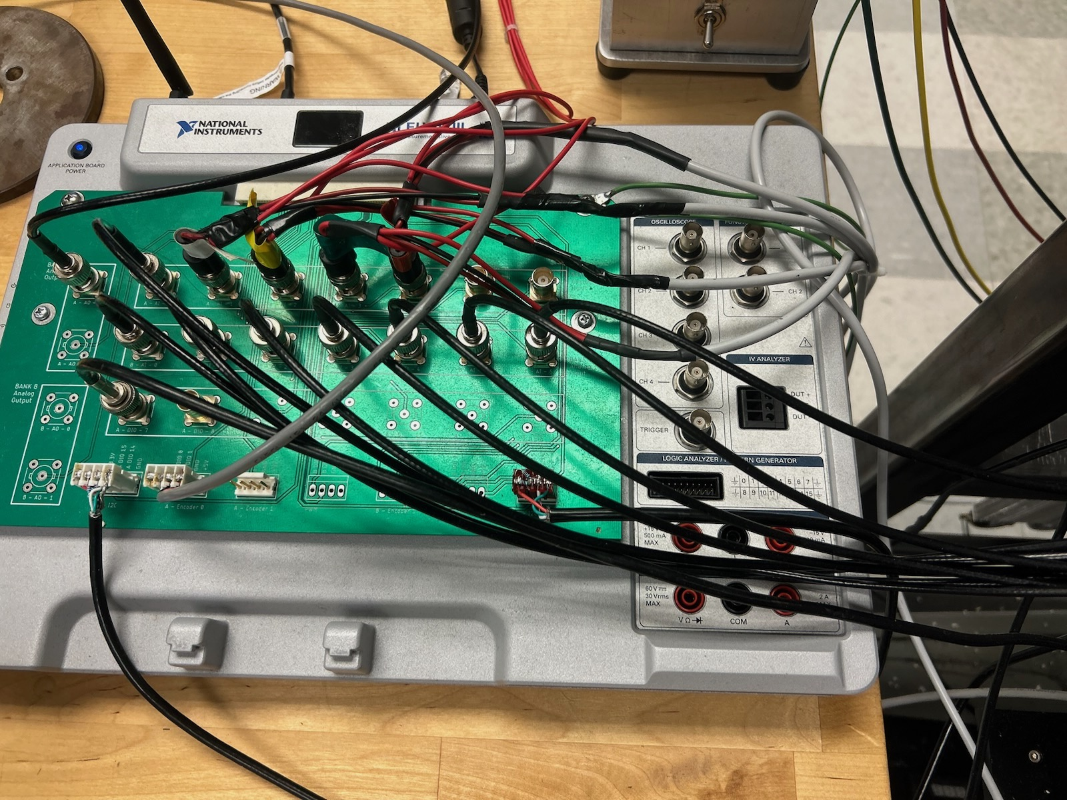
The Problem
ME 4056’s DAQ System has high-cost (~$3000)
Currently being phased out by NI
Old DAQ System

Slide 4
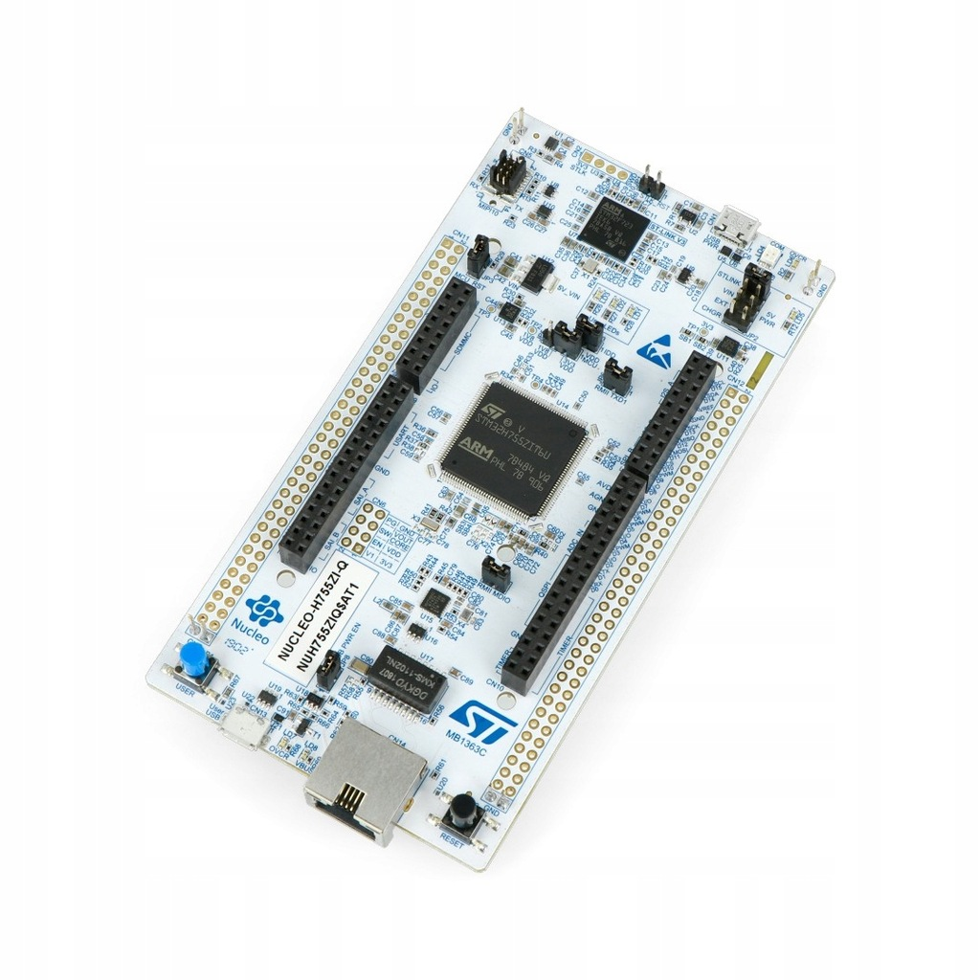
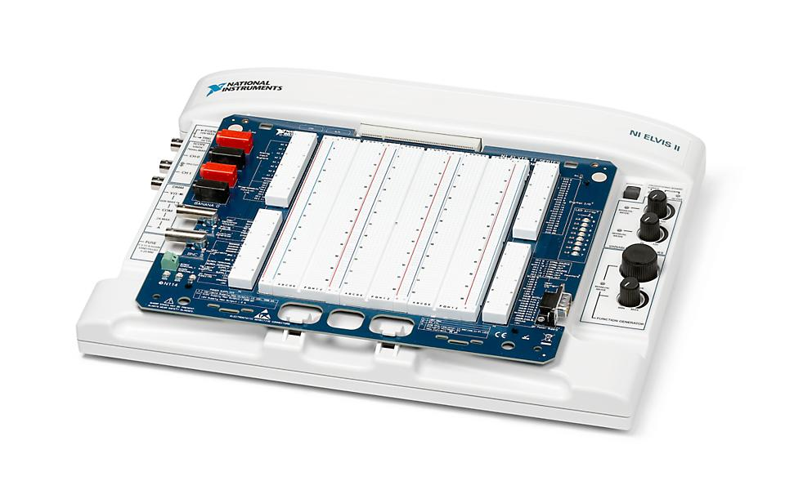
Our Project
Develop Data Acquisition System Compatible with Current ME 4056 Experimental Setup and with Cloud based GUI. Verify system with function generator and physical system (RC Car).​
Old DAQ
New DAQ
($3000)
($300)

Slide 5
Subsystems
Microcontroller

Slide 6
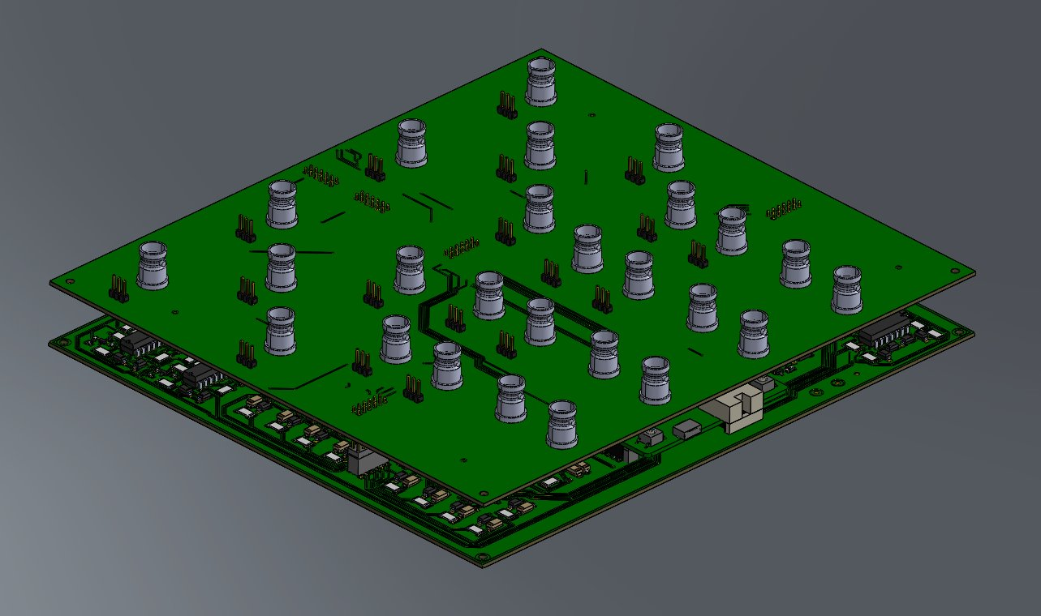
Subsystems
Interface Board
Microcontroller

Slide 7
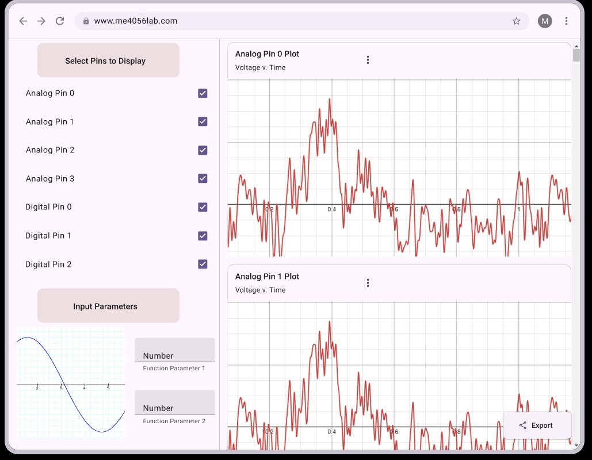
Subsystems
Interface Board
Microcontroller
Cloud GUI

Slide 8
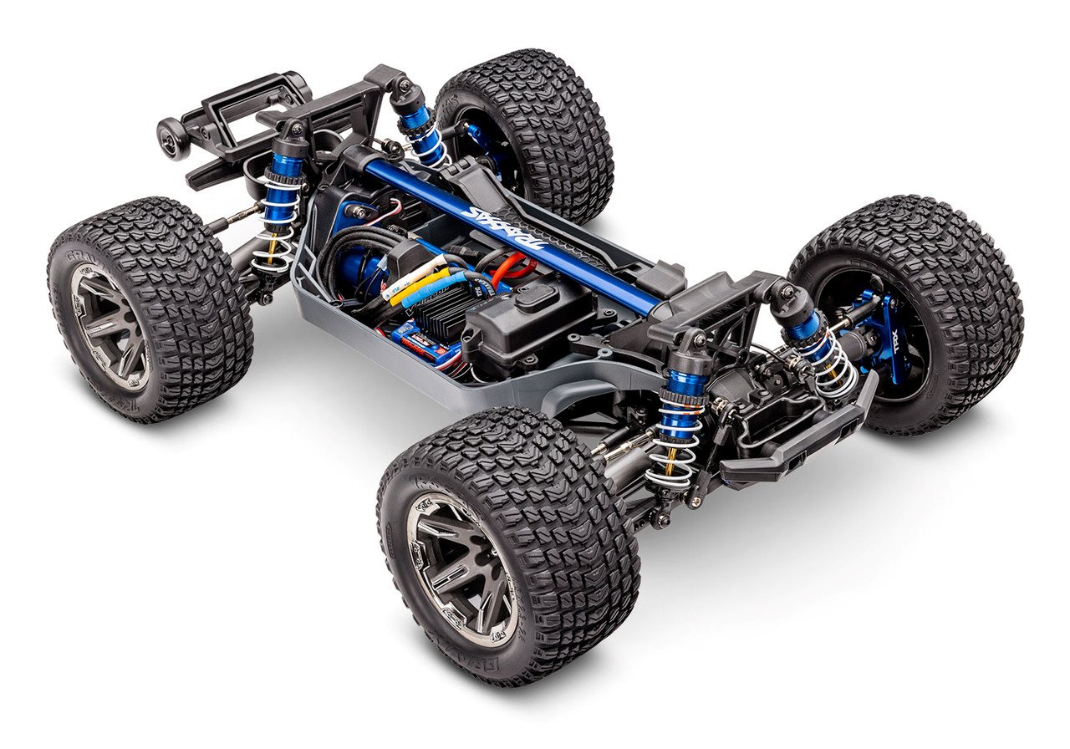
Subsystems
Test Bed (F1tenth)
Interface Board
Microcontroller
Cloud GUI

Slide 9
Microcontroller Requirements
10x Analog inputs
8x Digital inputs
2x I2C channels
2x Digital Frequency Monitors
2x PWM output channels
2x Function generator channels
Communicate to cloud via USB
Notes:
Digital frequency detection

Slide 10
Interface Board Requirements
Easy DAQ interface
Protect against controller overvoltage
Protect against controller overcurrent
Remove background noise

Slide 11
Cloud GUI Requirements
Collect, Store, & Visualize data from DAQ
Facilitate Communication between User and DAQ
Intuitive Interface to modify visualizations, creating adaptable dashboards for the labs

Slide 12
Validation Requirements
Simulate all potential inputs/outputs
Analog, digital, I2C, PWM, function generator
Simulate lab experiments
Optimize lap time
Portable testbench

Slide 13
Microcontroller

Slide 14
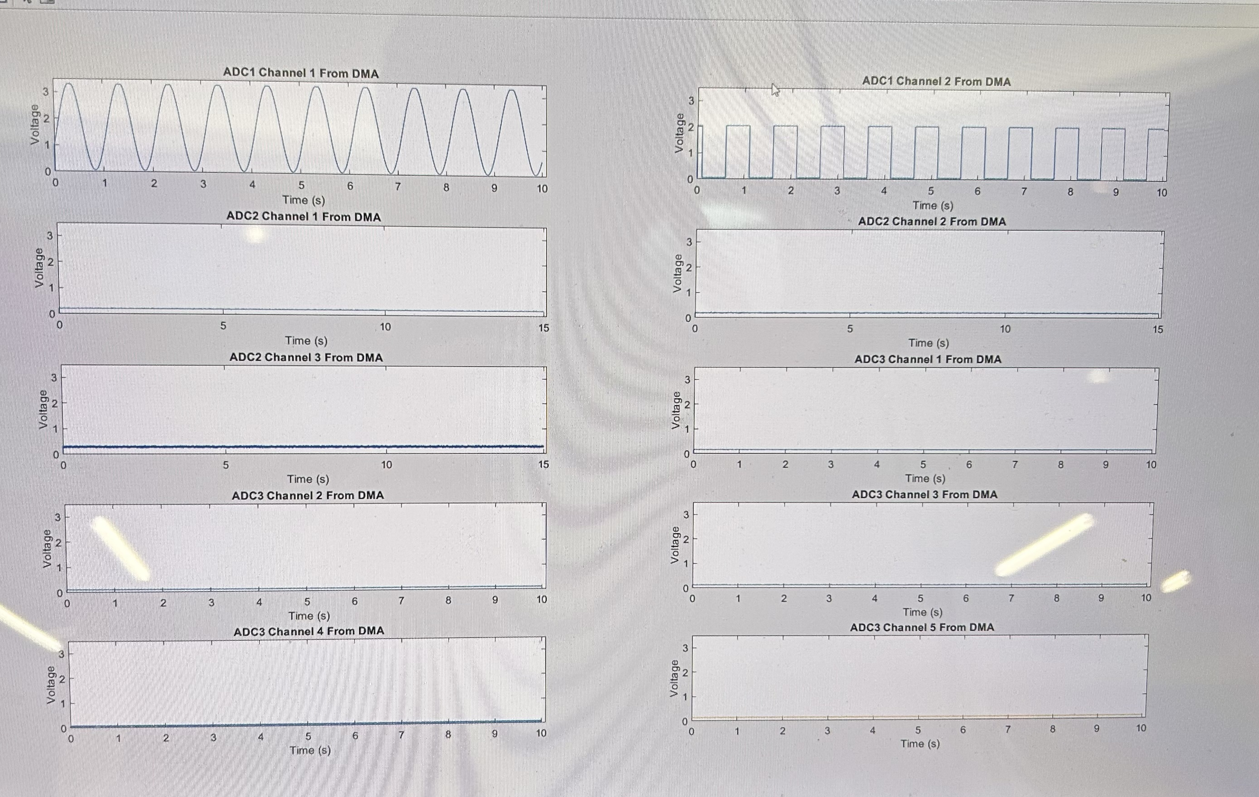
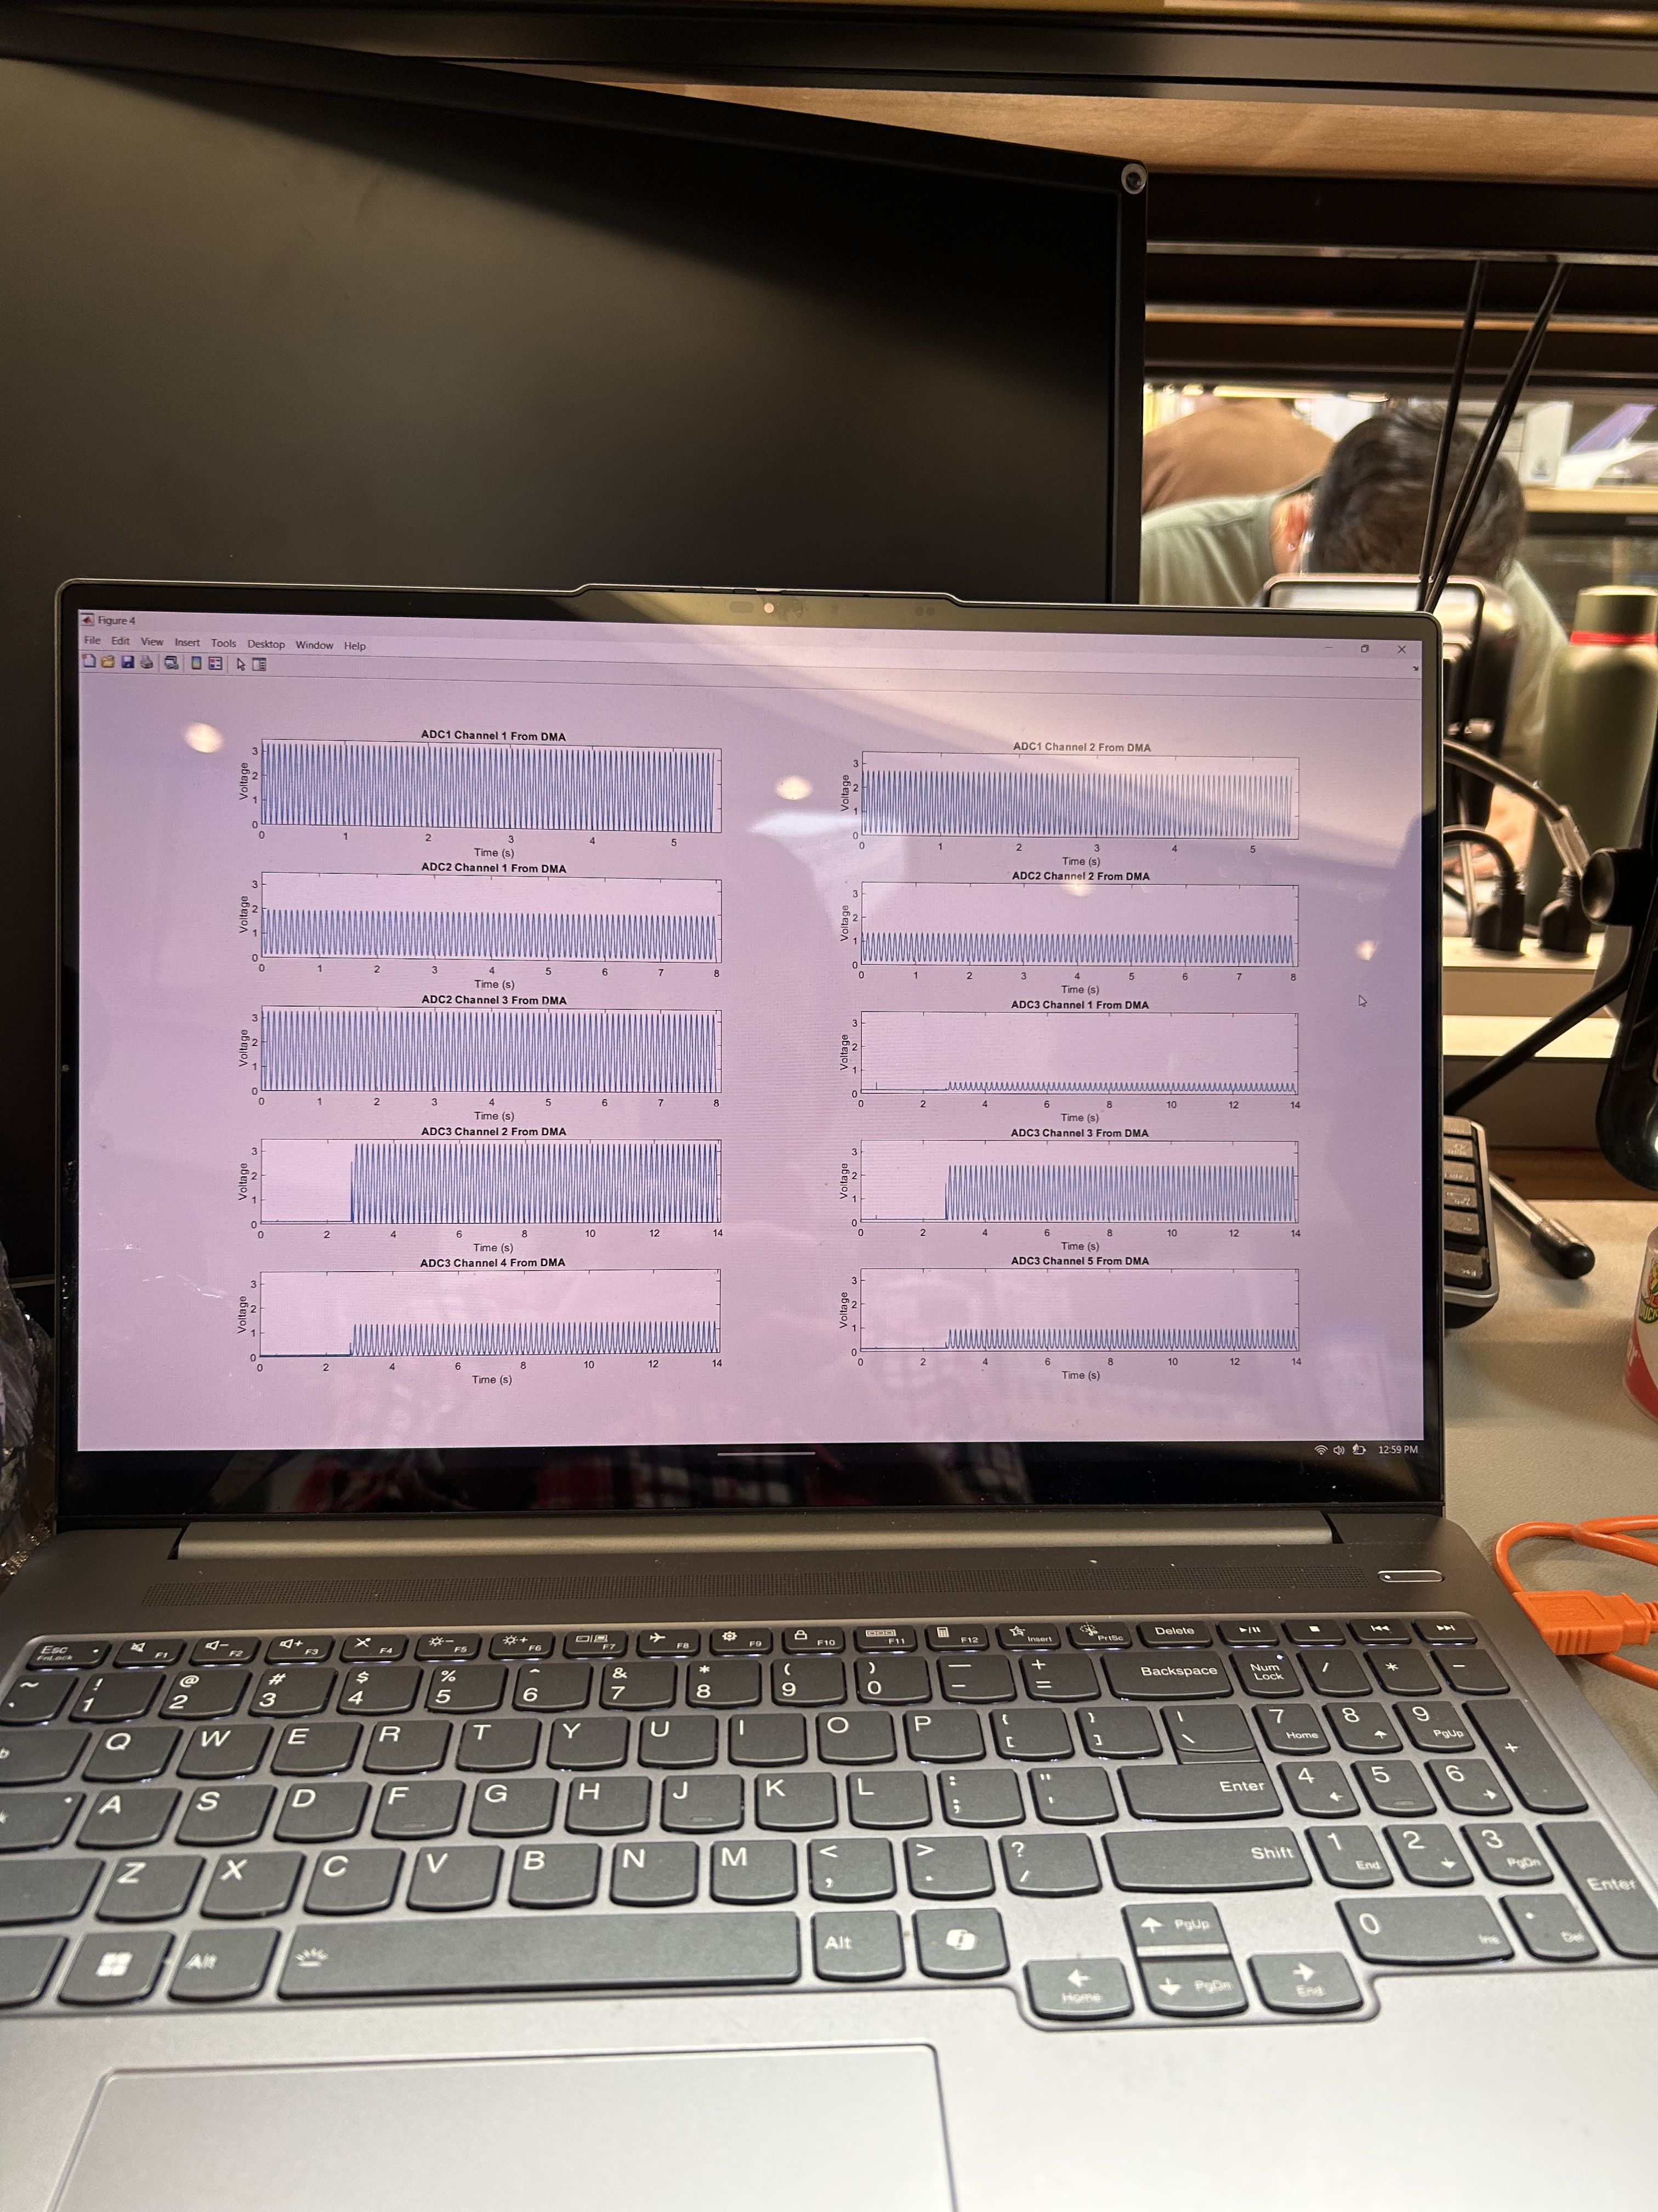
STM Software Progress
Achievements to date
RTOS
Multi-Threading
ADC
Analog-to-Digital-Conversion with DMA
Cross-Core Communication
Can send information from M4 to M7
Output Peripherals Tests
UART Communication Tests

Slide 15
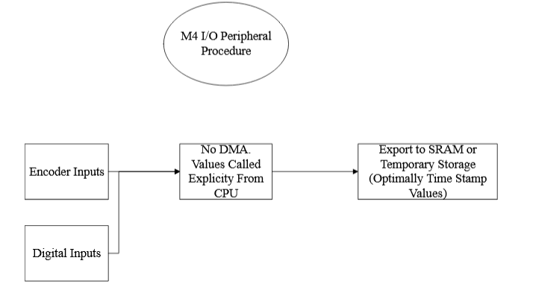
M4 State Diagram

Slide 16
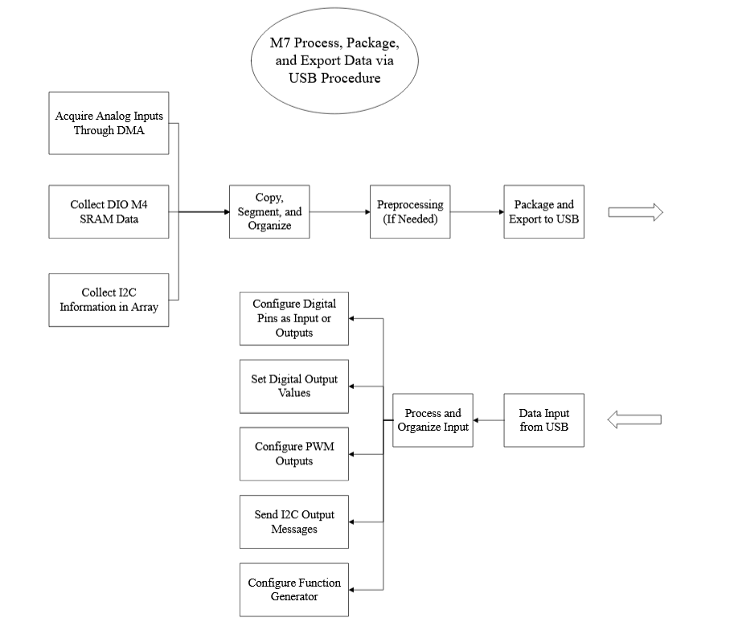
M7 State Diagram

Slide 17
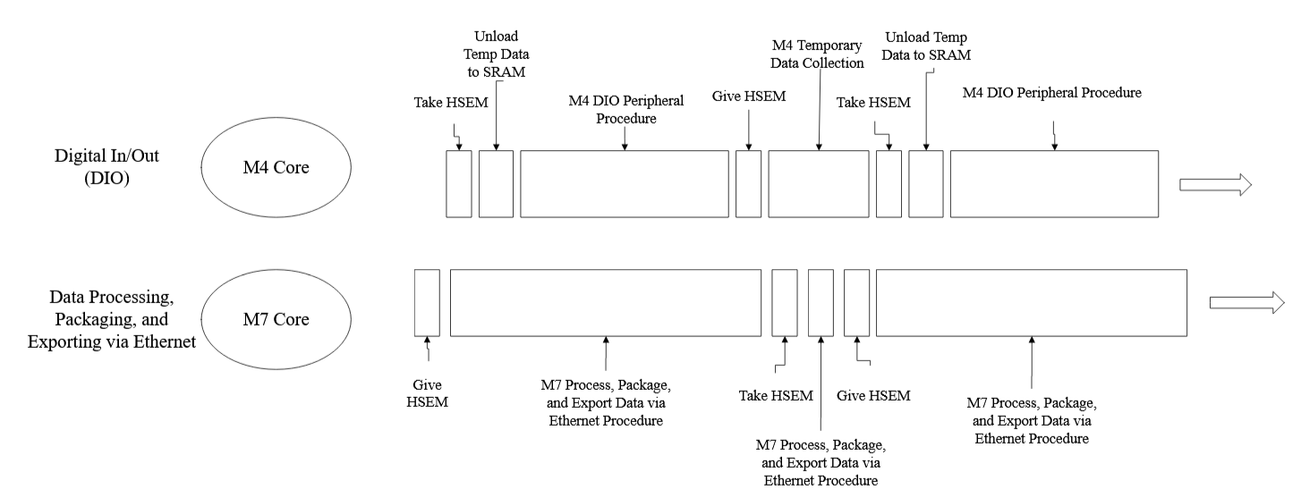
HSEM Cross Core Communication – High-Level

Slide 18
Microcontroller: Next Steps
Complete M4 Digital I/O Collection and Cross Core Communication
Complete M7 ADC to Optimal Sampling Speed
Implement M7 Peripheral Code
Setup RTOS for Data Sending/Receiving Data

Slide 19
Interface Boards

Slide 20
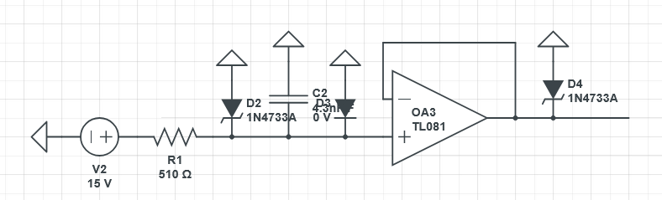
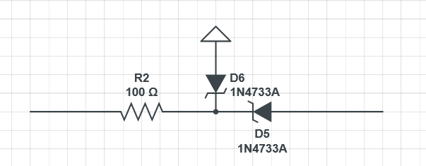
0-3.3V Input Range
Notes:
Main goal is to protect the STM with incoming signals and mechanically with case and easier inputs
BNC for easy connection
Voltage and current protection
Noise reduction
Shows boards and case

Slide 21
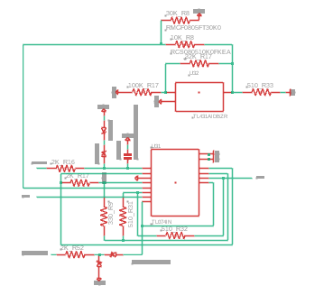
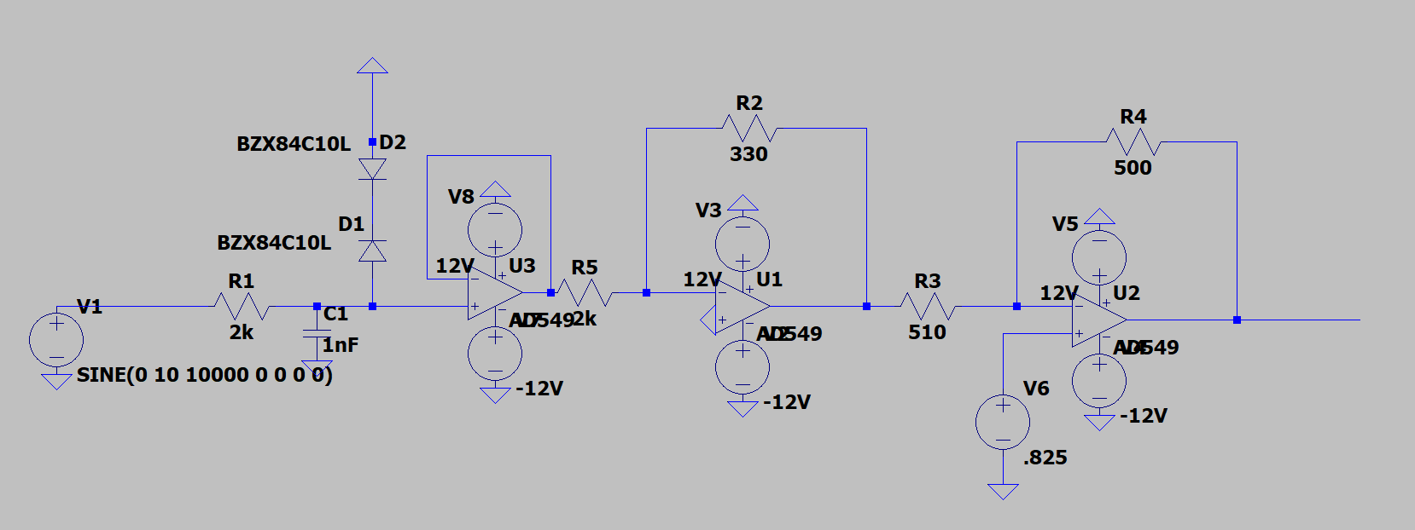
-10 to 10V Input Range

Slide 22
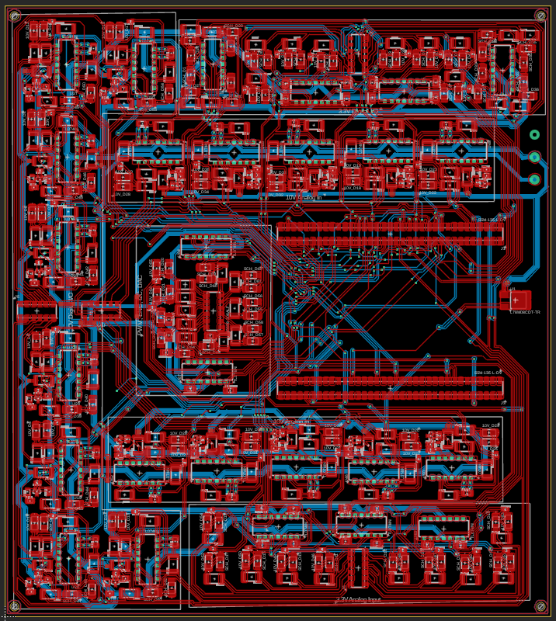

Slide 23
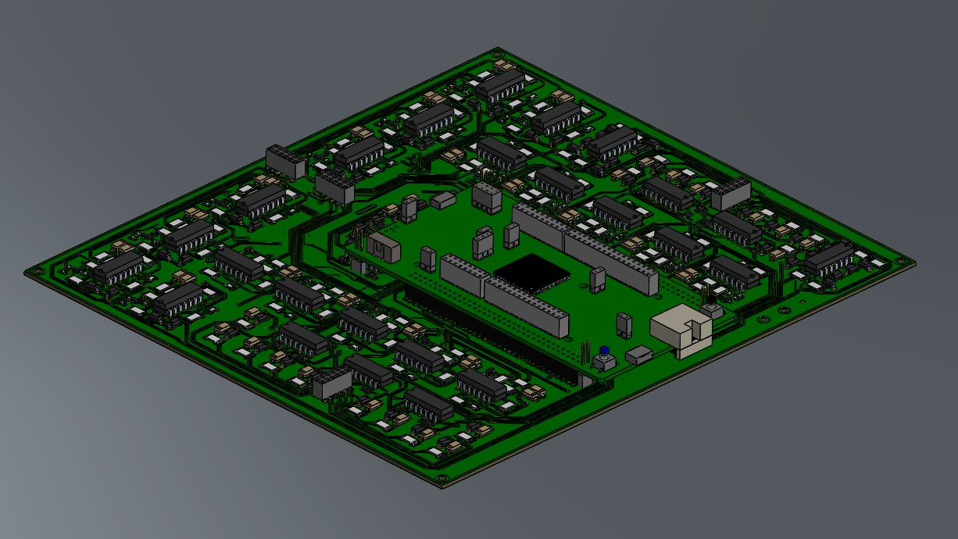

Slide 24
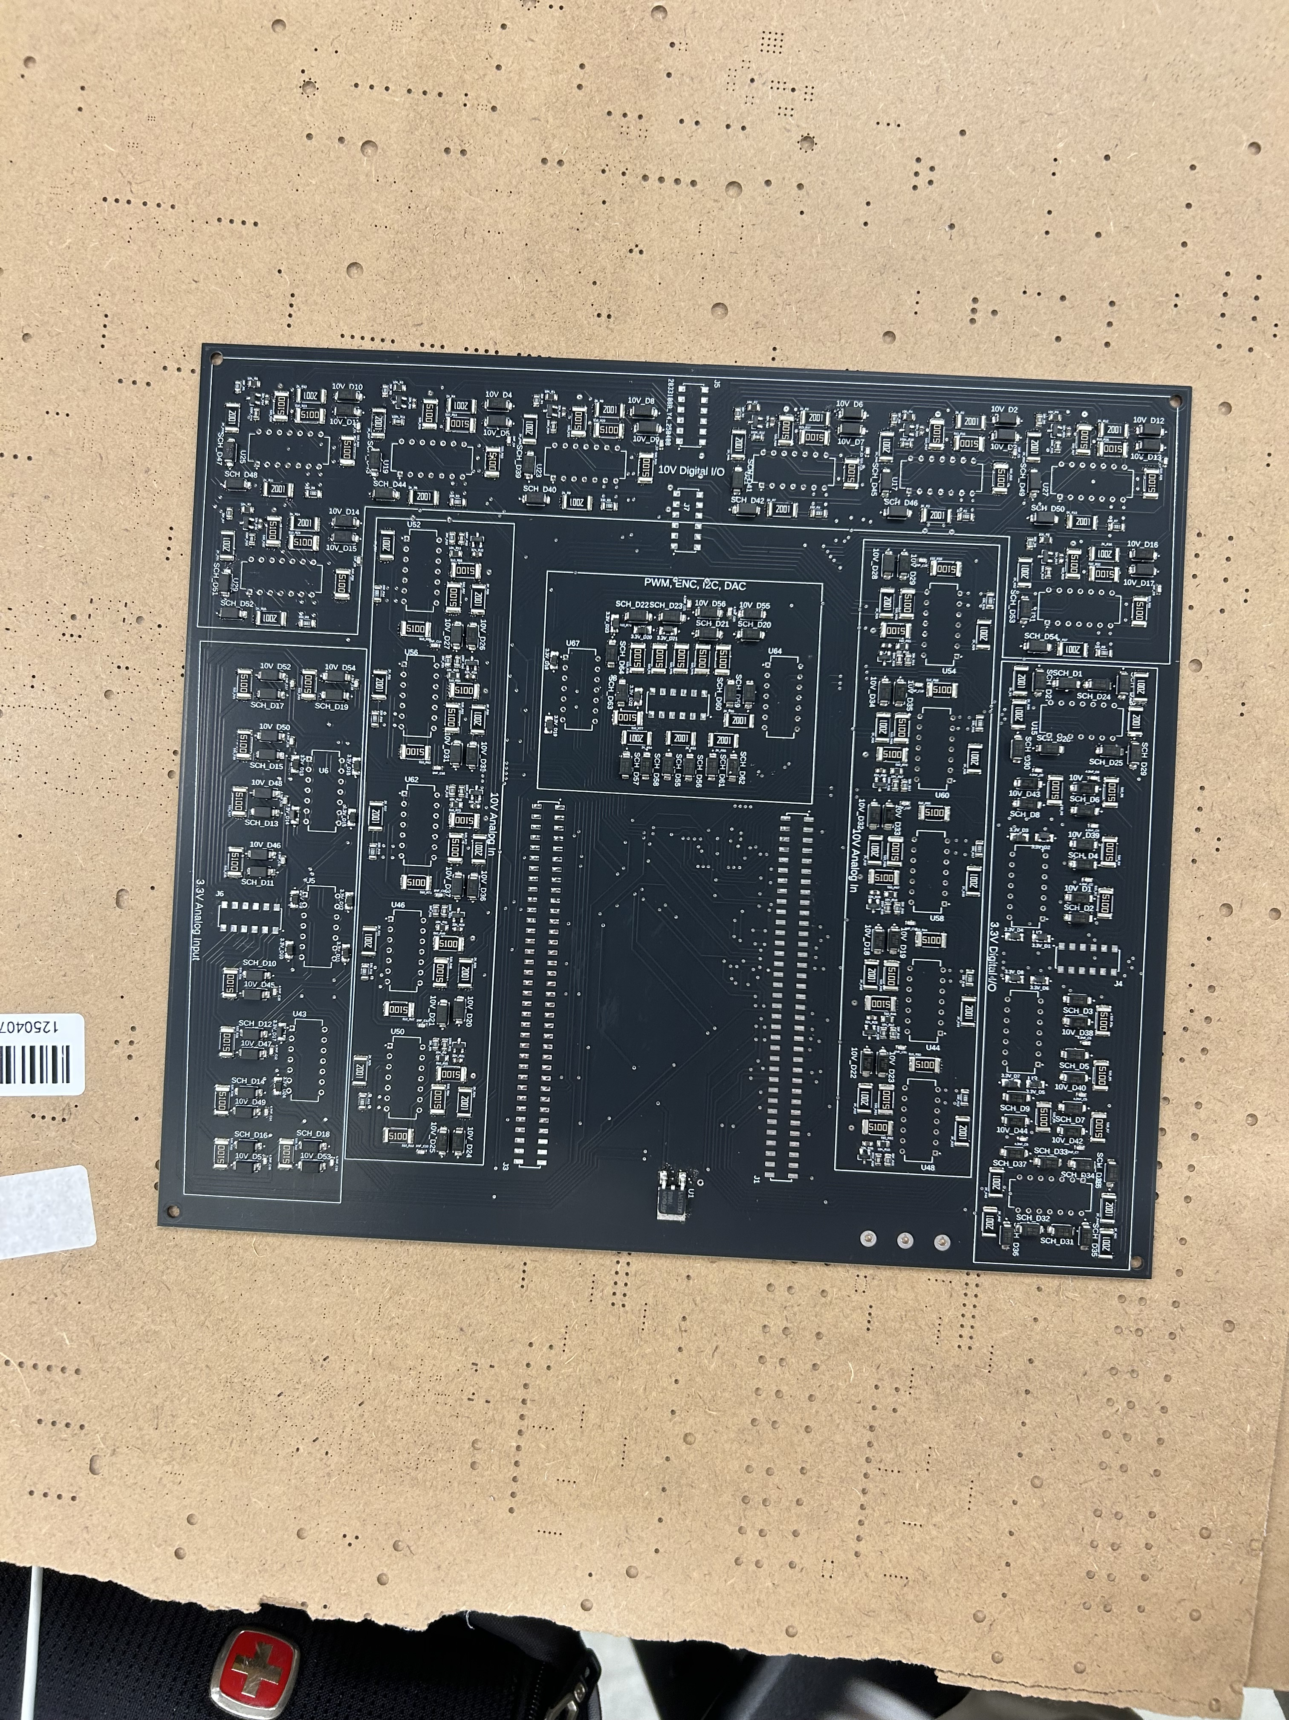

Slide 25
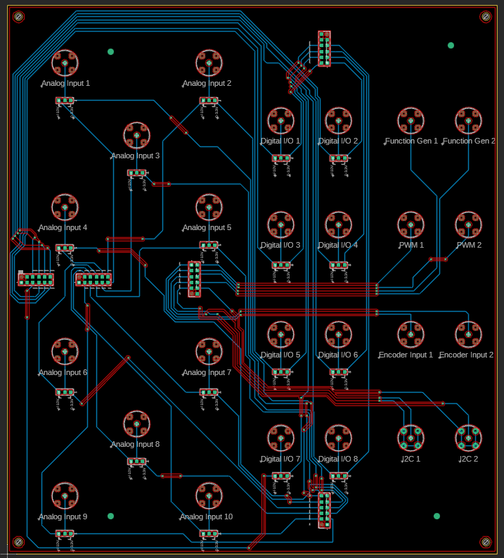

Slide 26
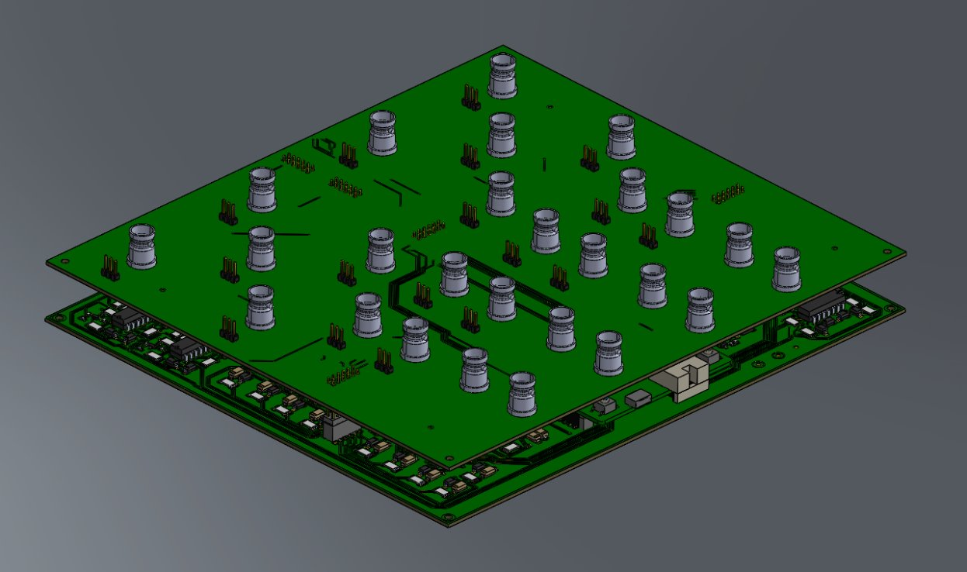

Slide 27
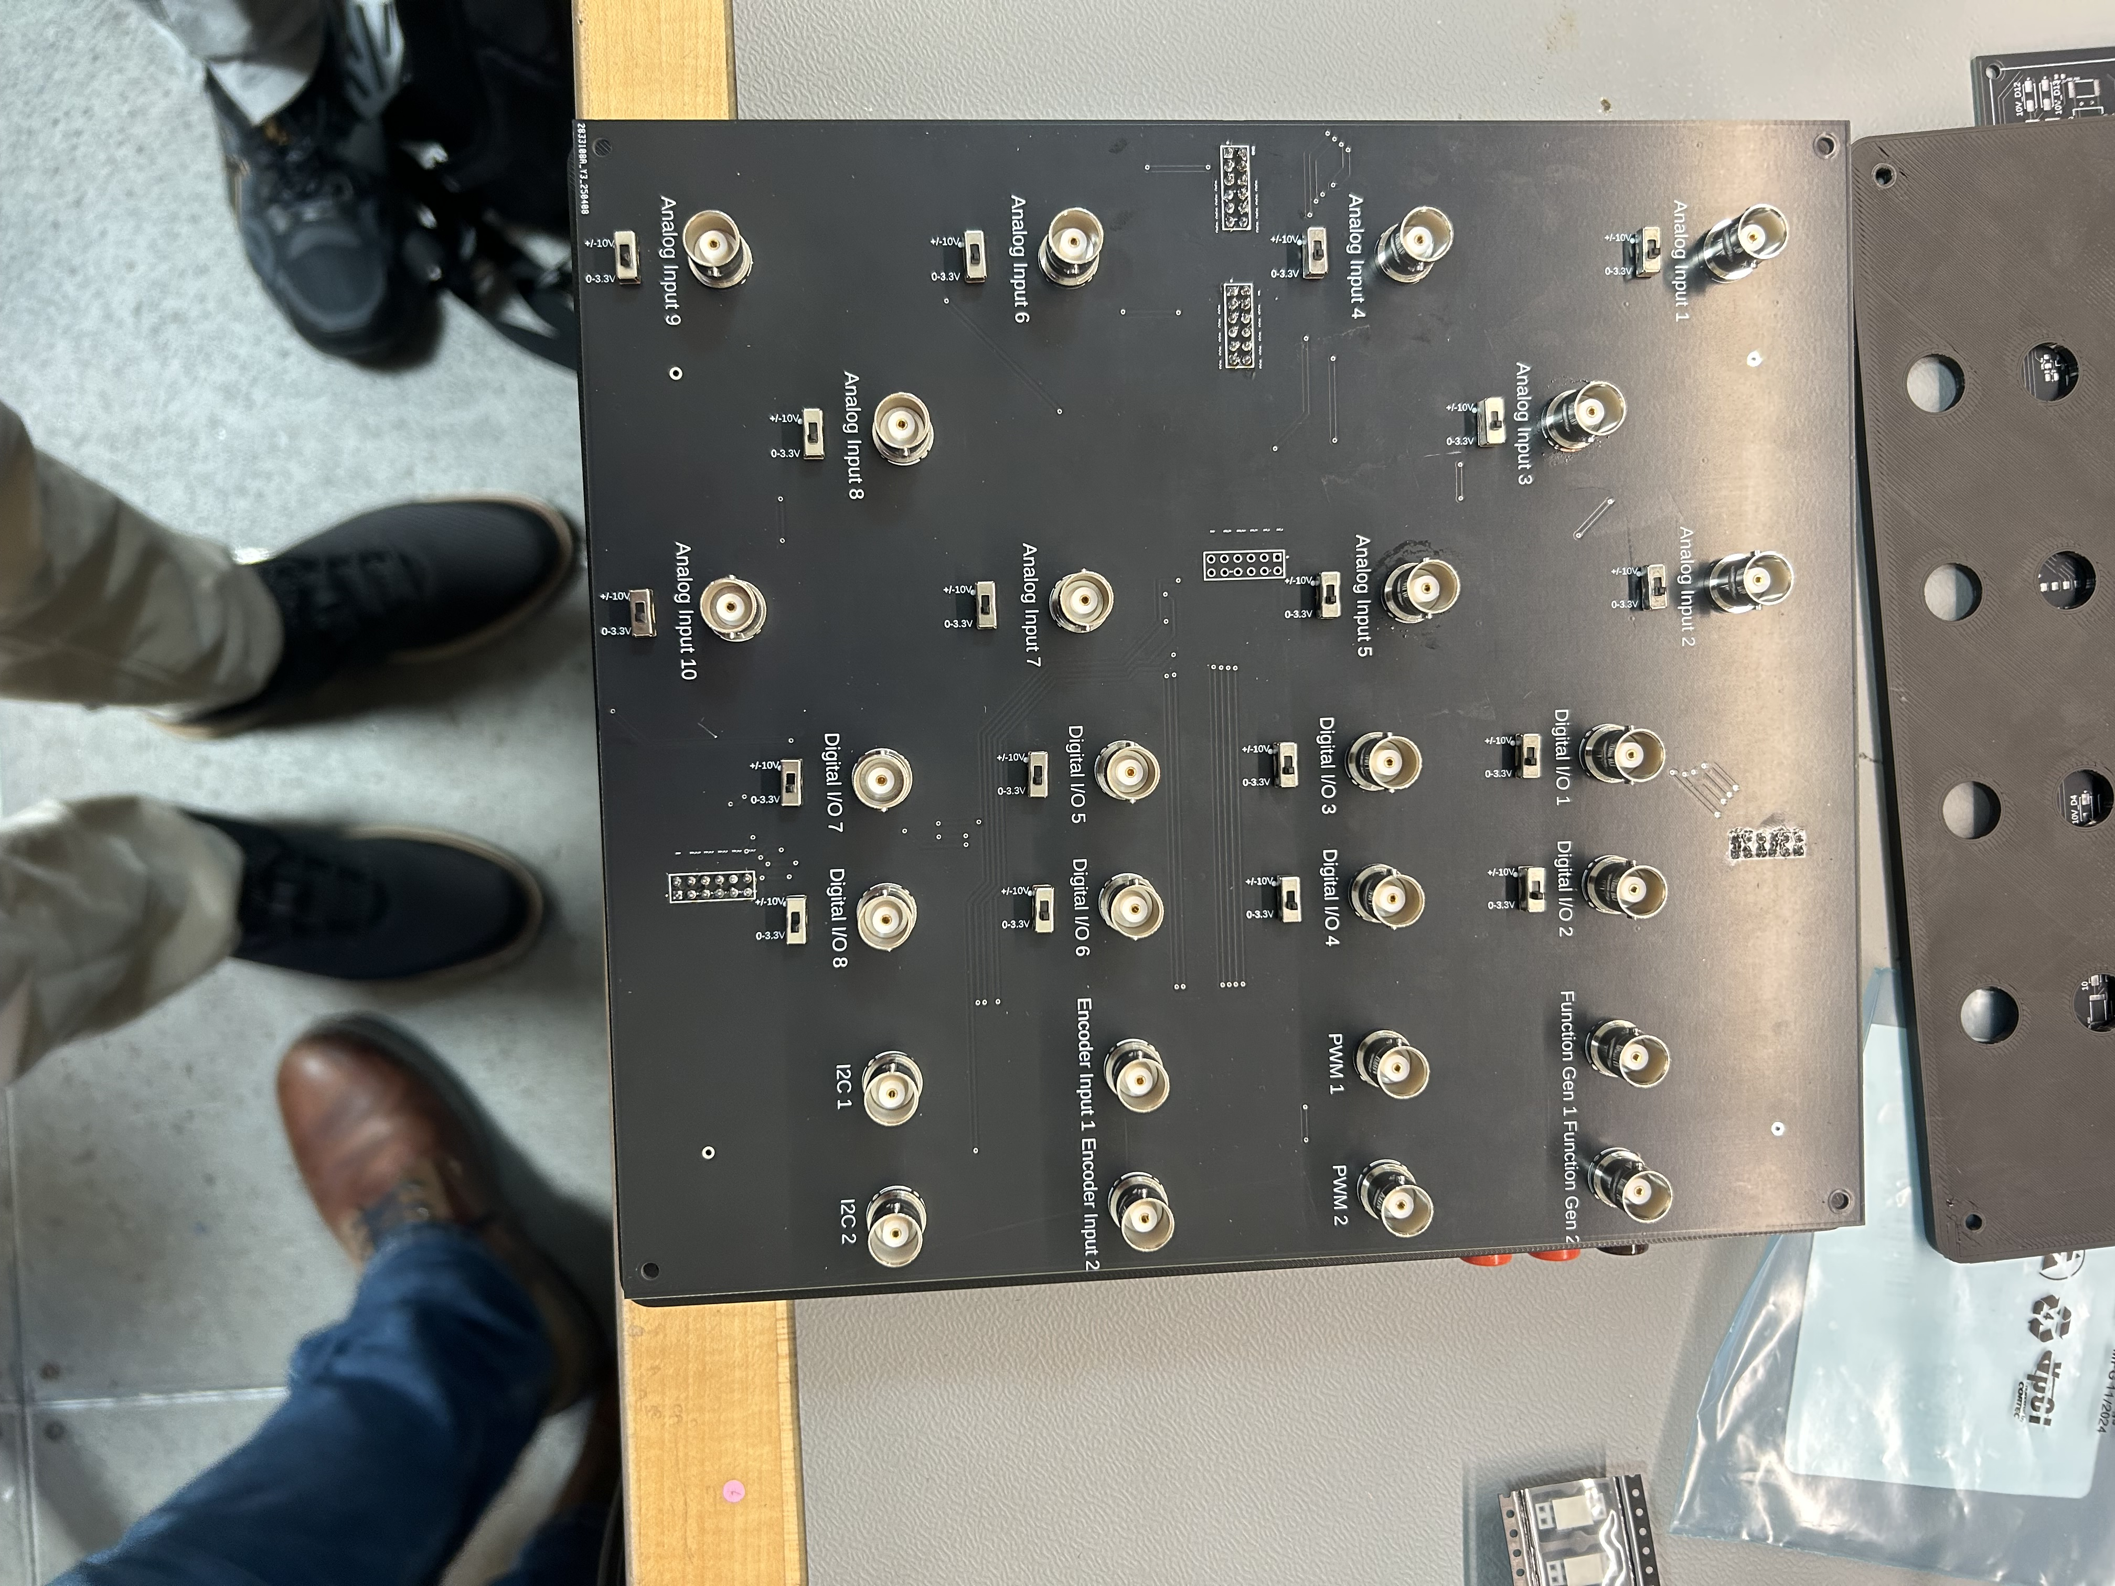

Slide 28
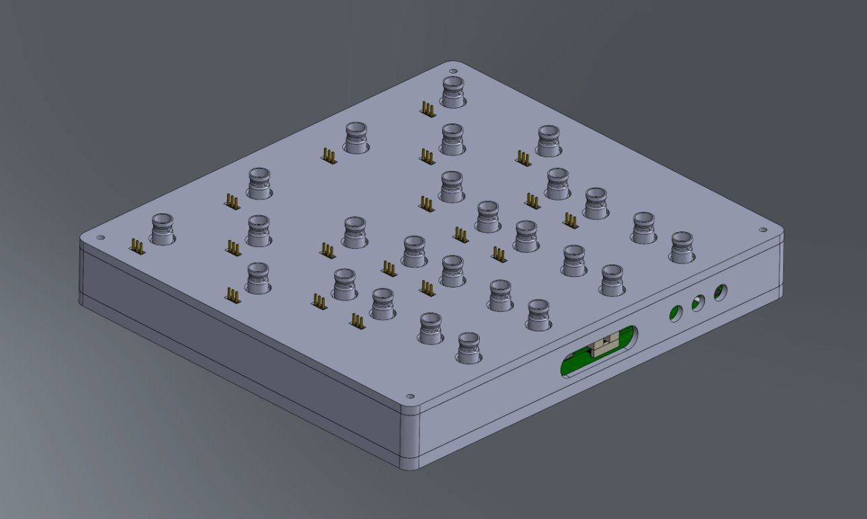

Slide 29
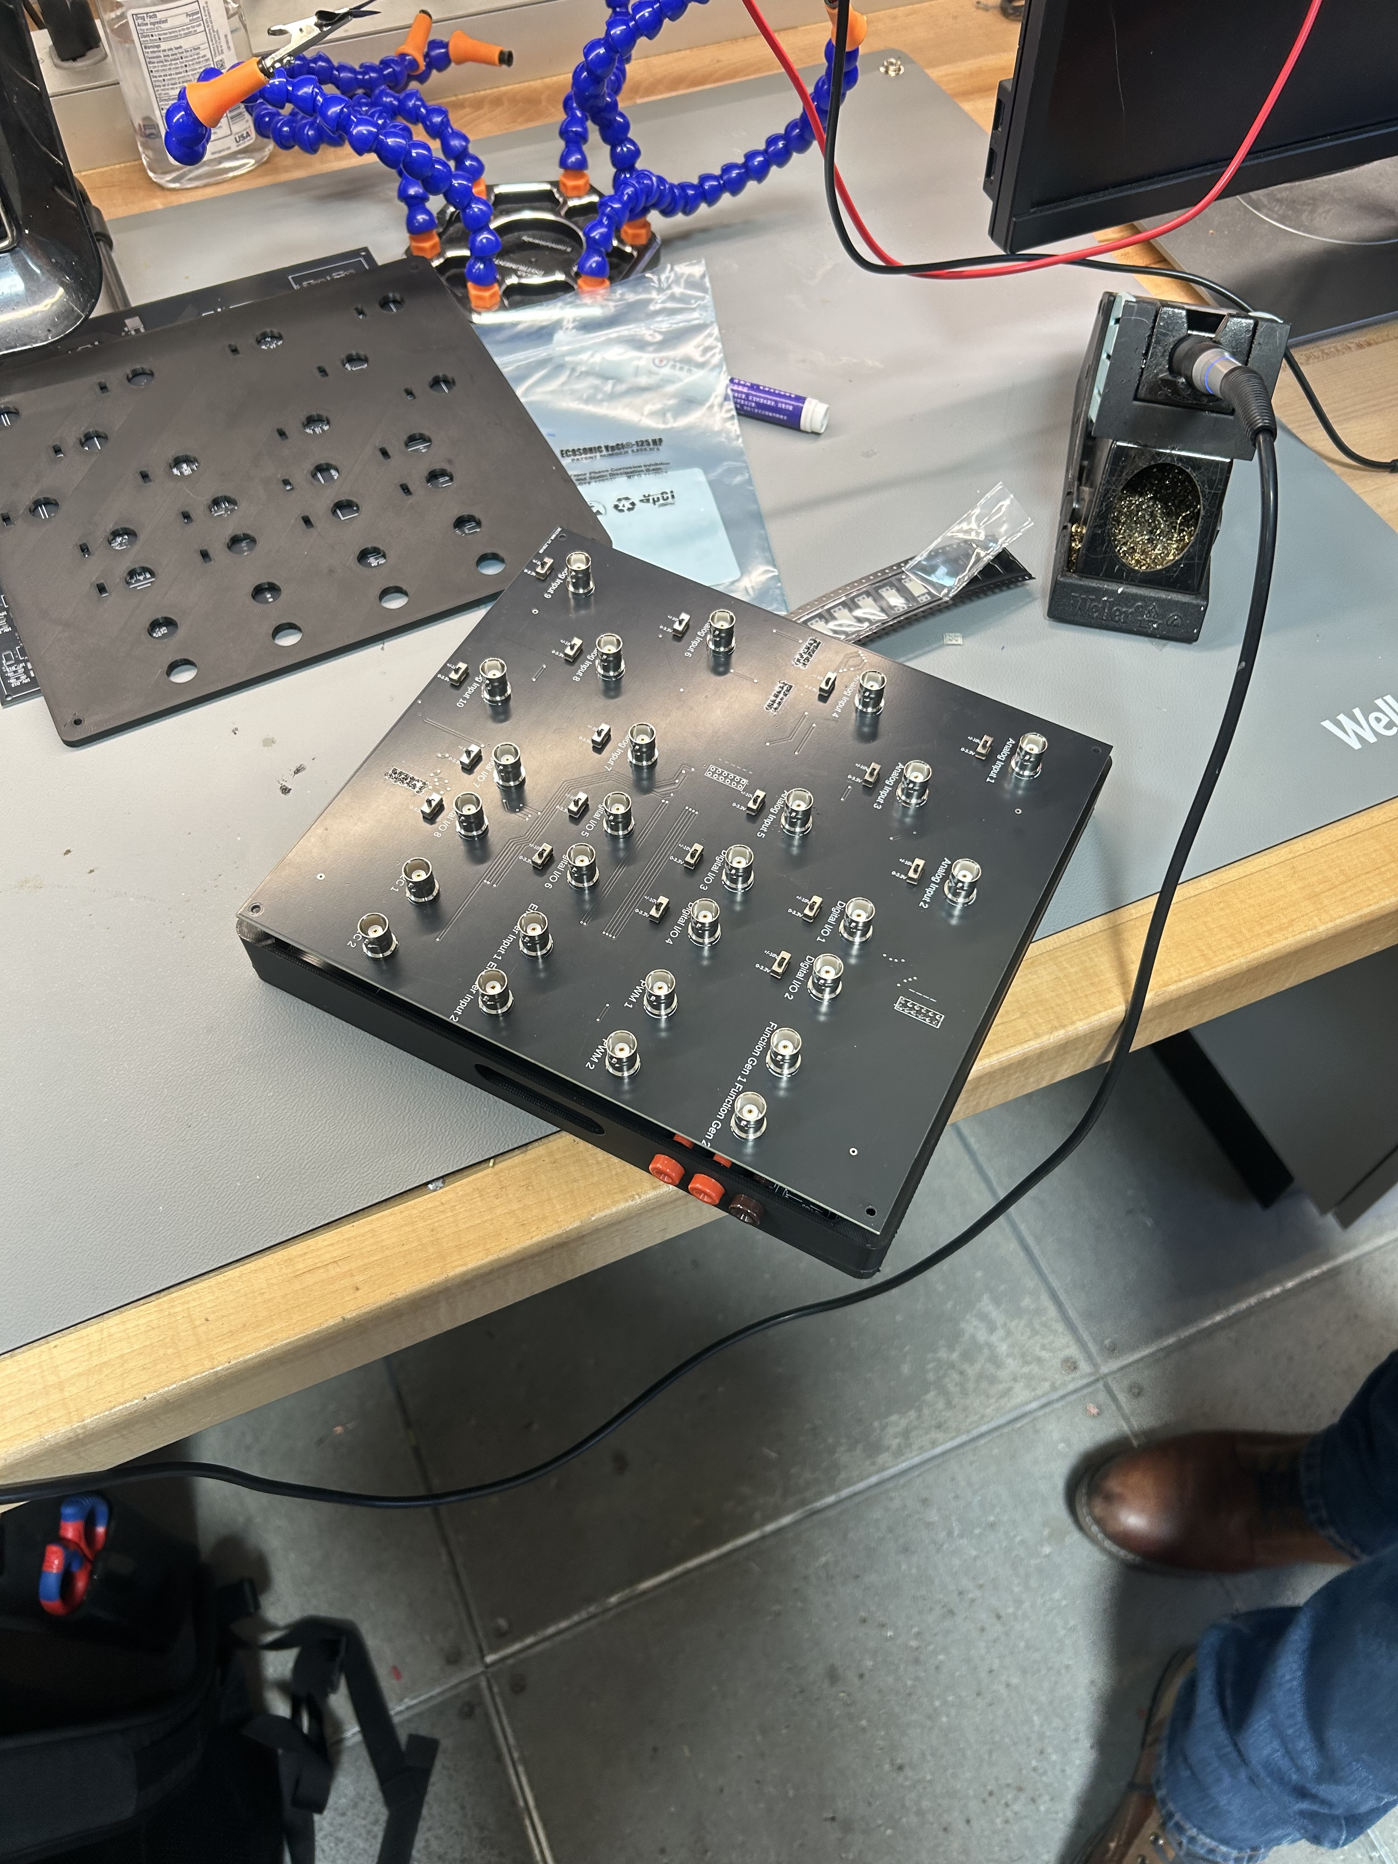

Slide 30
Interface Boards: Next Steps
Complete Signal Processing Board
Debug if Necessary
Test and Record Capabilities

Slide 31
Cloud GUI
Notes:
-Live Plotting -User Interface -Selection of Pin Offsets -Dashboarding (Moveable /Creatable Graphs, Selectable Axes, Saveable Configs)
-Send User Inputs back to DAQ

Slide 32
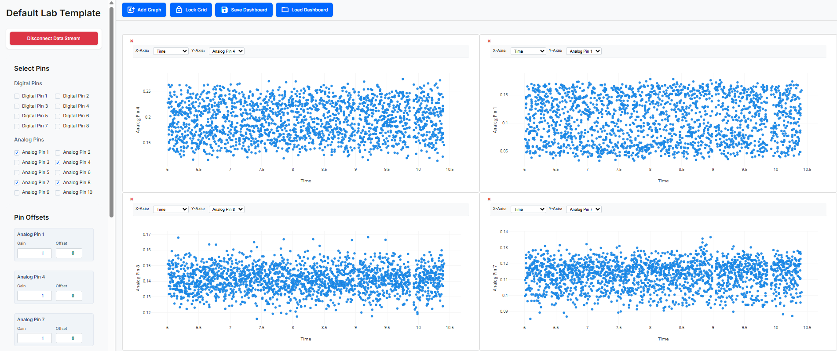
Implemented Features

Slide 33
Interactive Analog & Digital Sensor
Plots that update in
Real-Time
Notes:
Make this live

Slide 34


Live Plotting
UART (Serial USB)
Microcontroller
Database
Live Plots

Slide 35
Live Plotting
Instructors Can Verify Authenticity
UART (Serial USB)
Microcontroller
Database
Live Plots

Slide 36
User Interface
Users Can Easily Select Desired Sensors
& Set Analog Gain/Offsets for Calibration

Slide 37
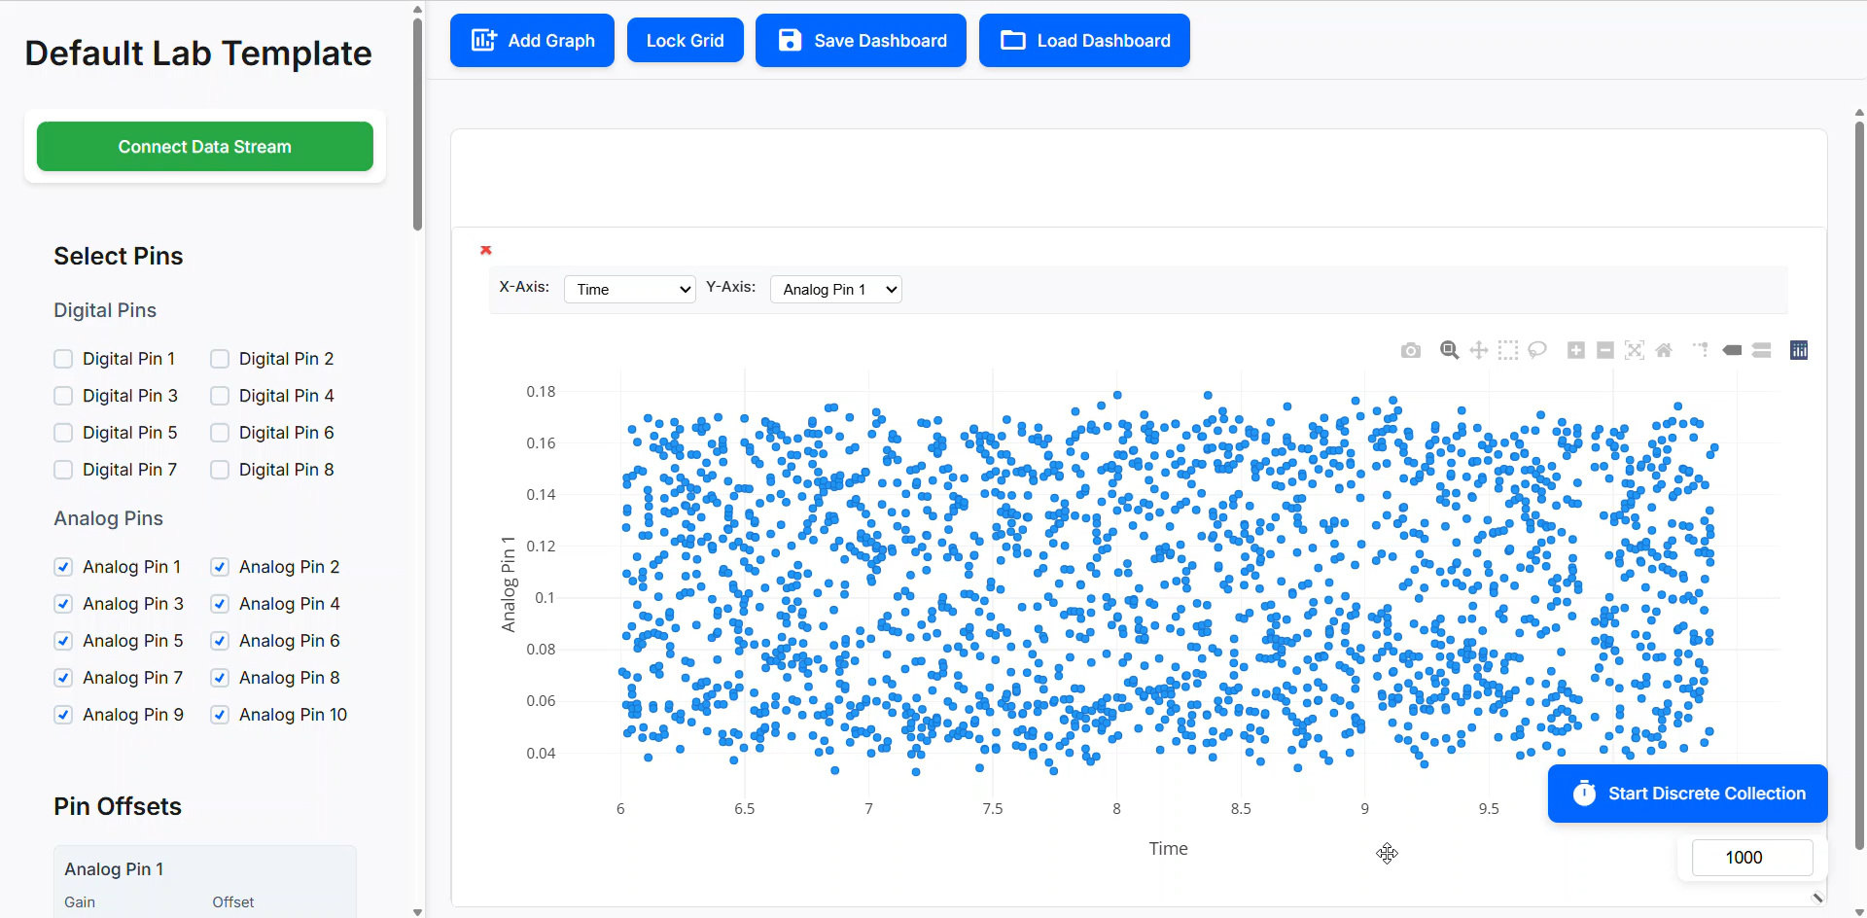
Powerful Dashboarding
Fully Customizable Graph Layouts (Size, Placement, and Number)

Slide 38
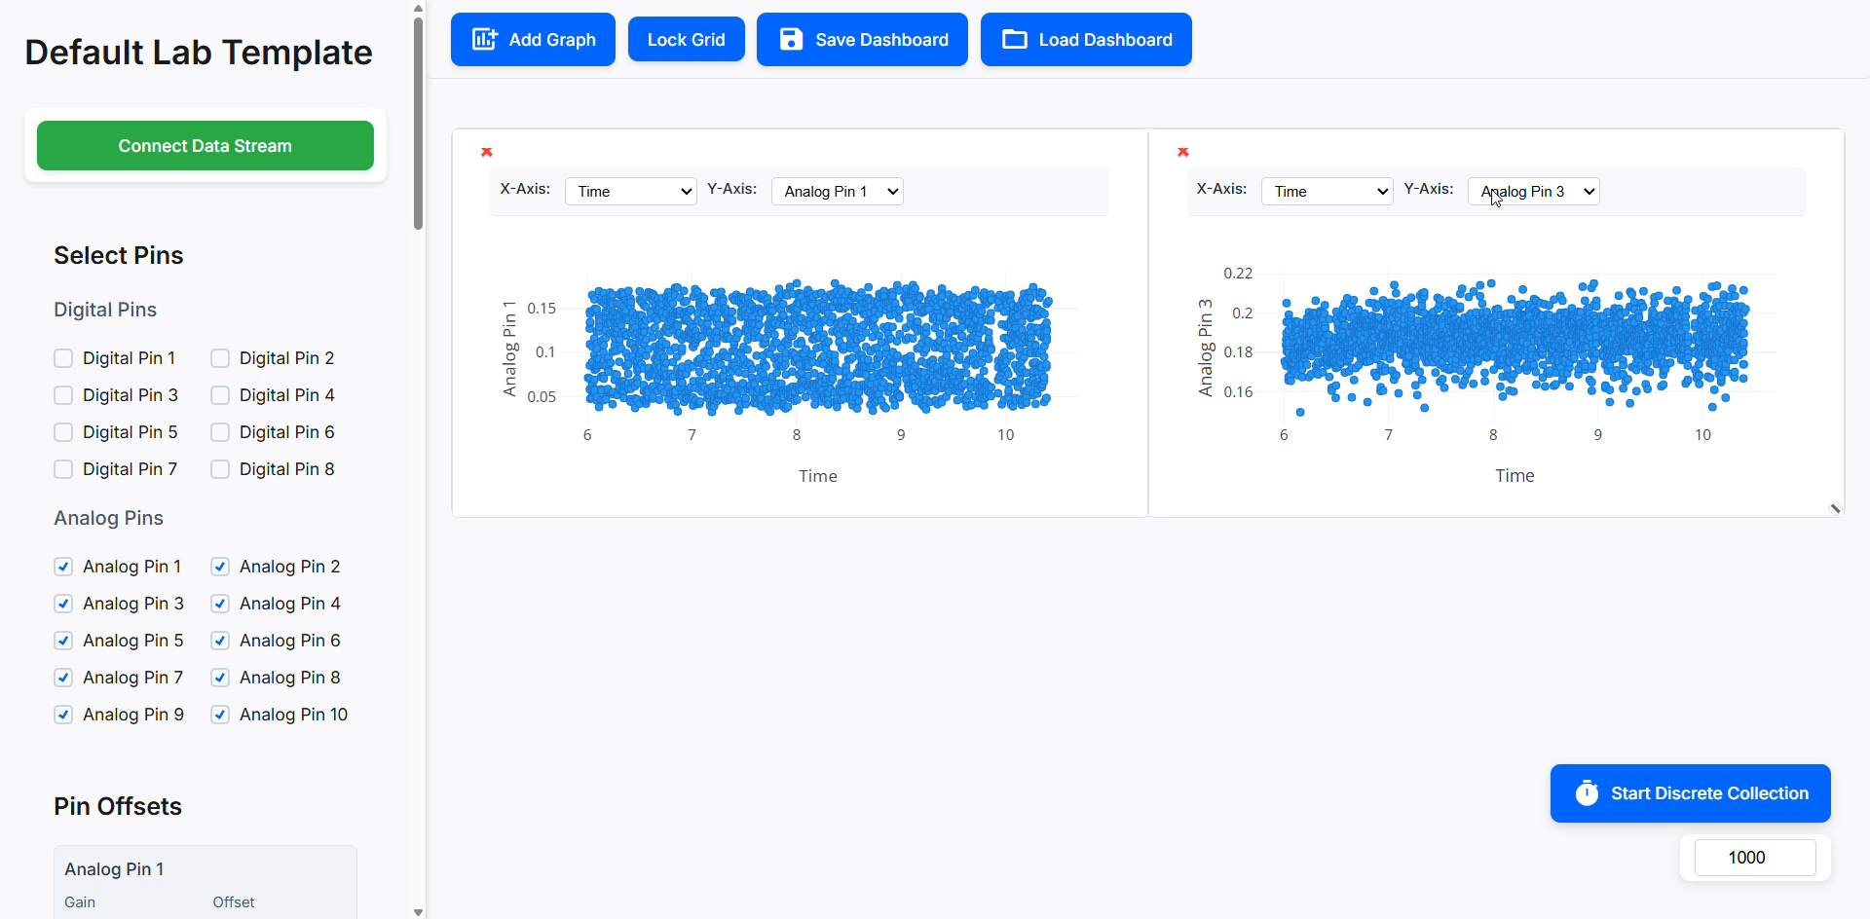
Selectable Plotting Axes for each Graph
Sensor vs. Sensor or Sensor vs. Time

Slide 39
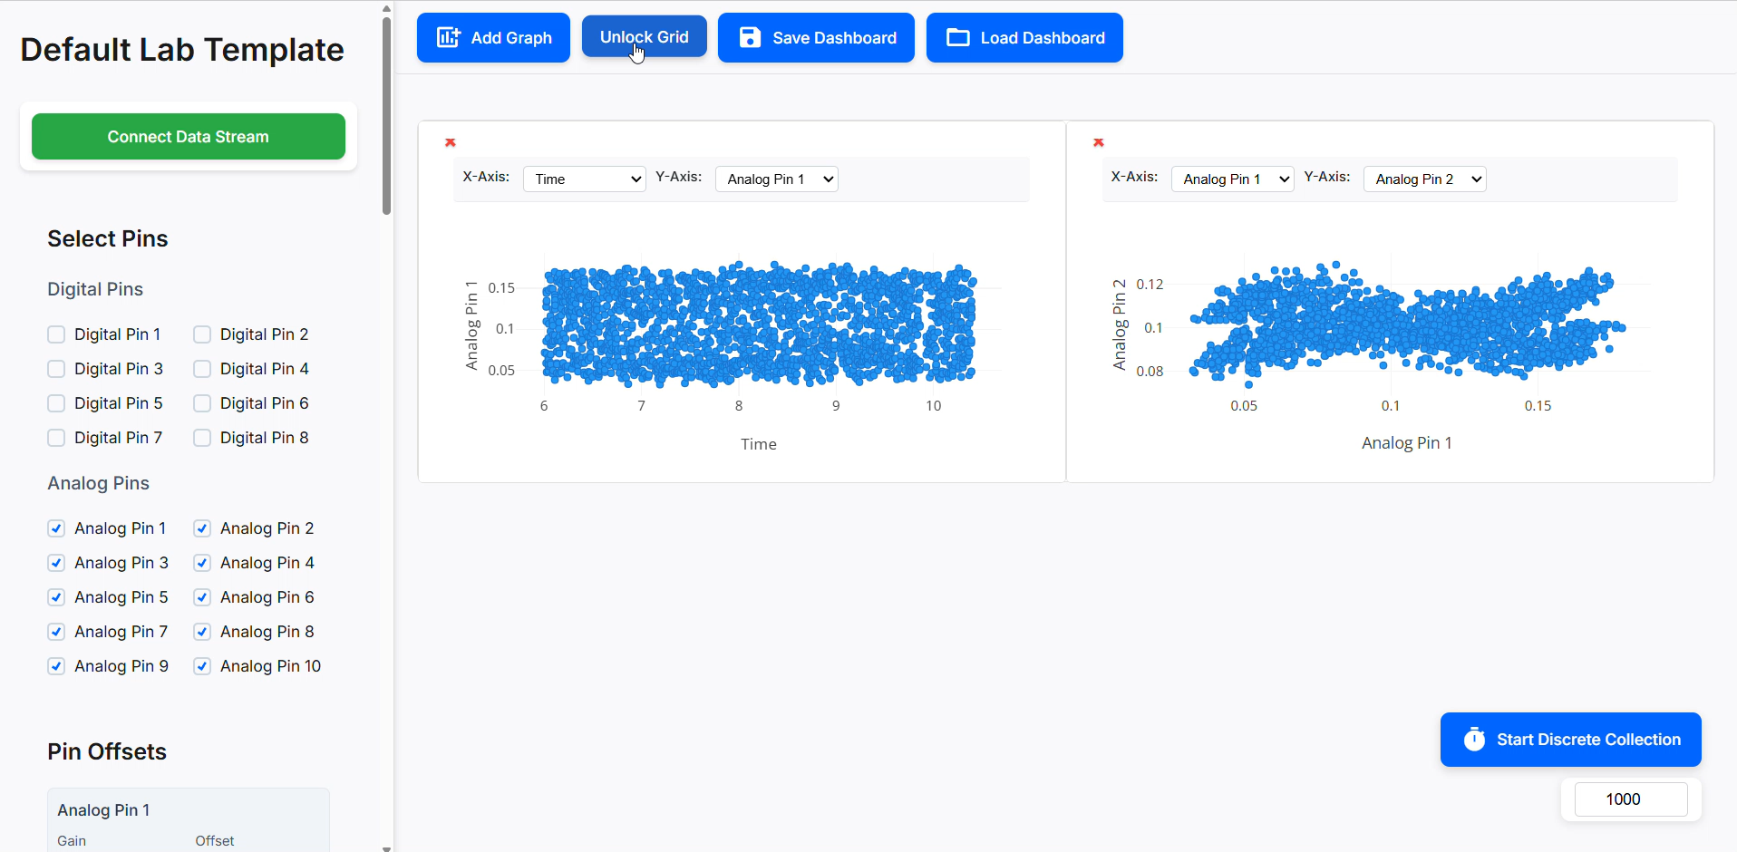
Save Dashboard Configs
Allows Instructors to easily create & distribute dashboards for each specific lab

Slide 40
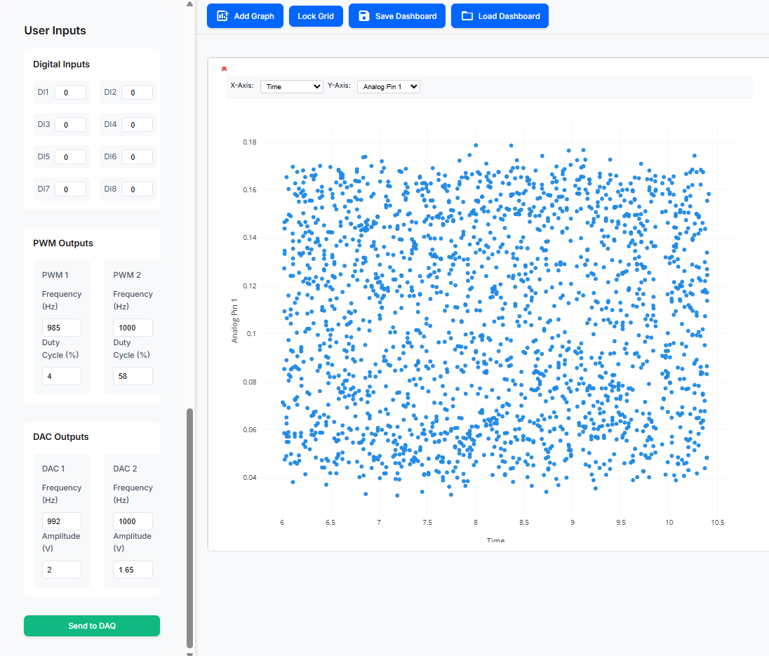
Communication to DAQ
Users Can Also Communicate PWM, DAC, DI Settings to the DAQ

Slide 41
Testing

Slide 42
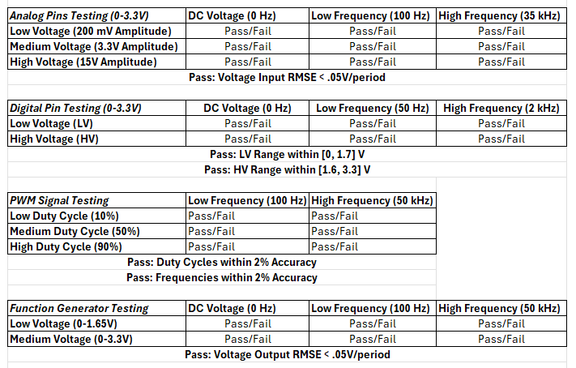
Final Design Characterization

Slide 43
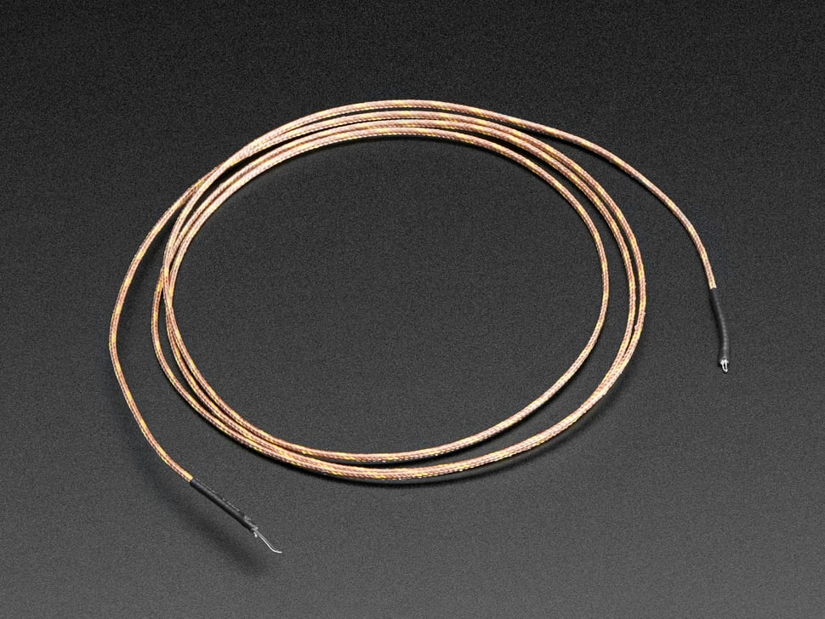
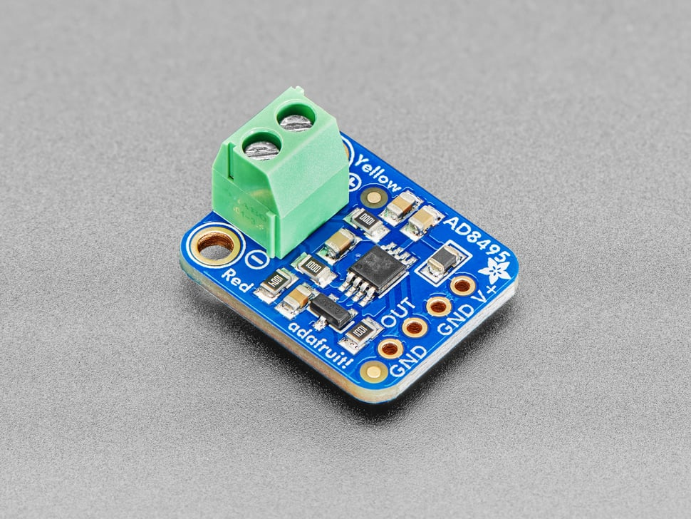
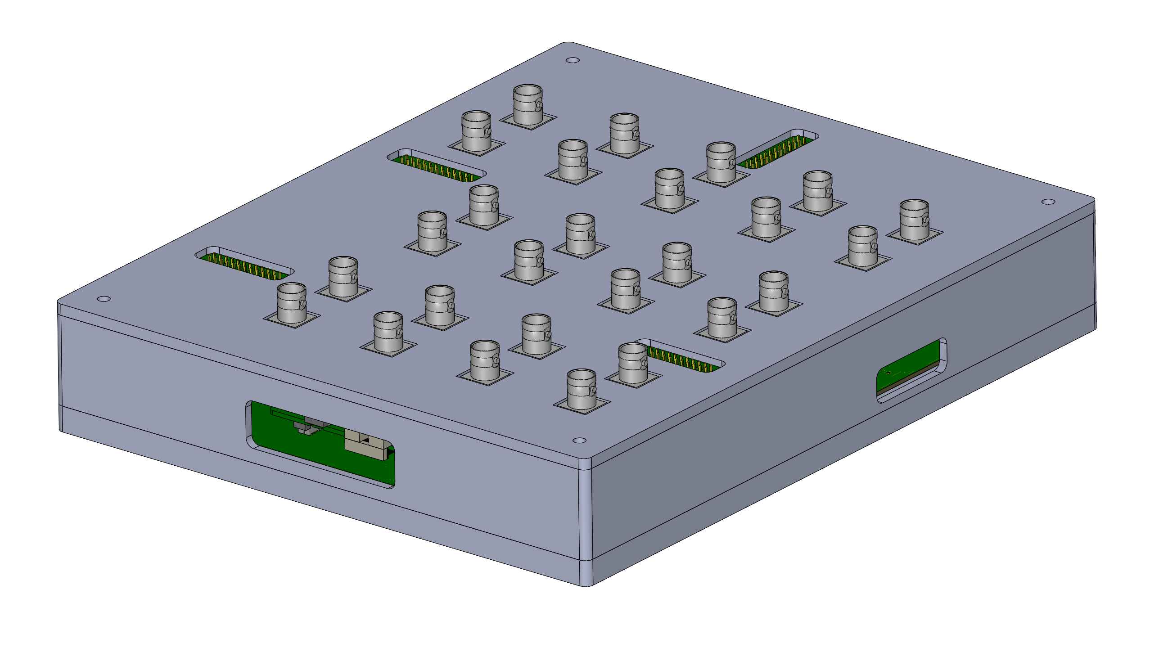
Analog

Slide 44
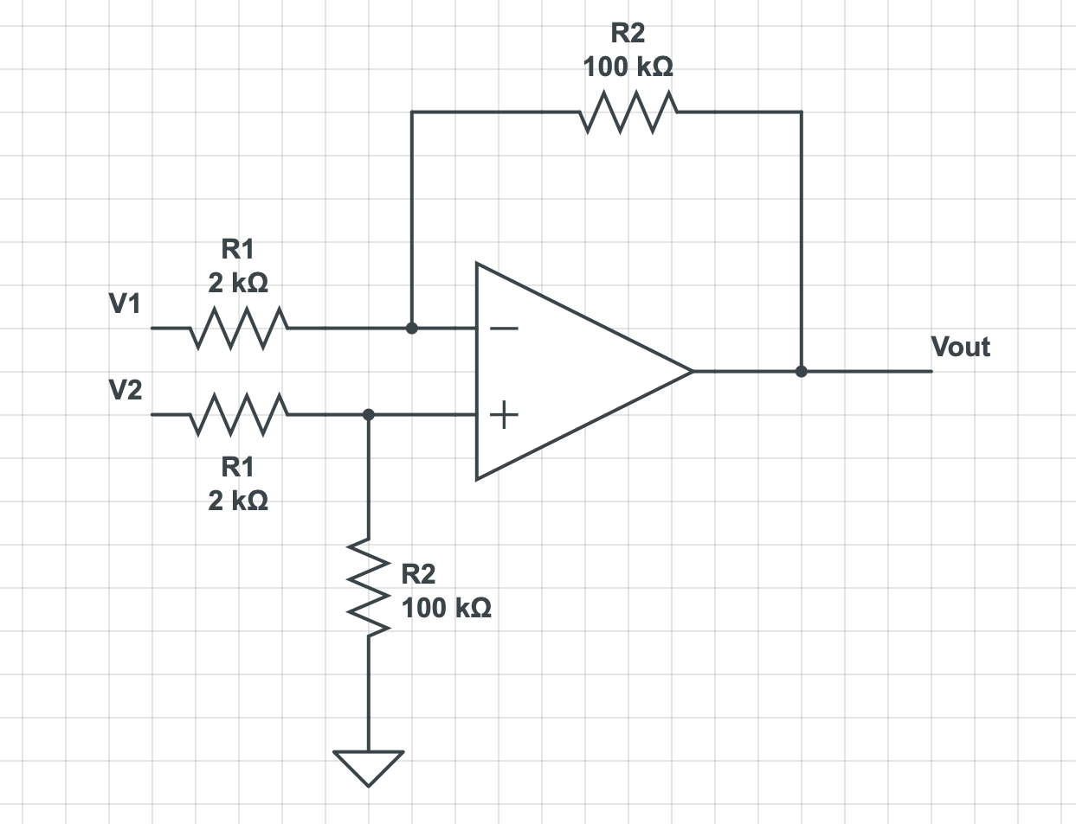
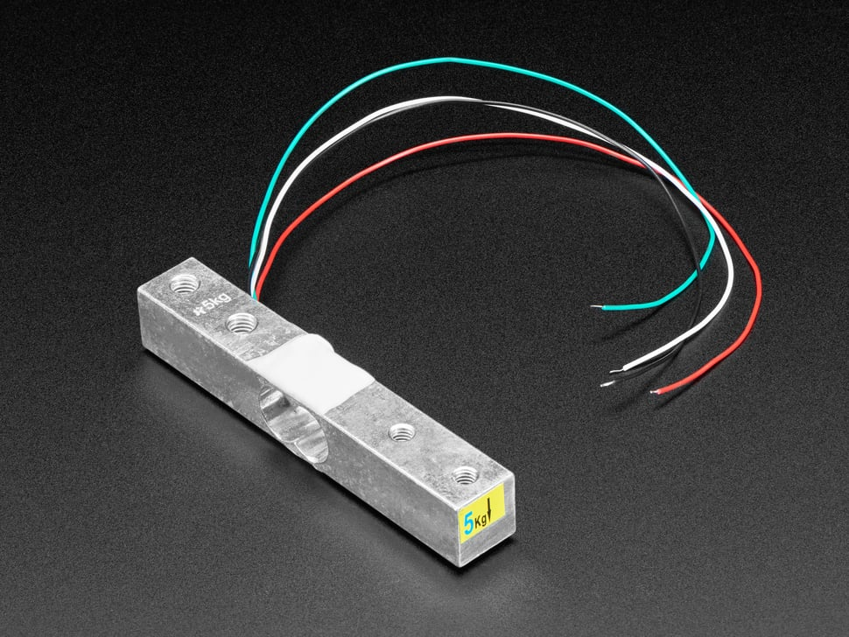
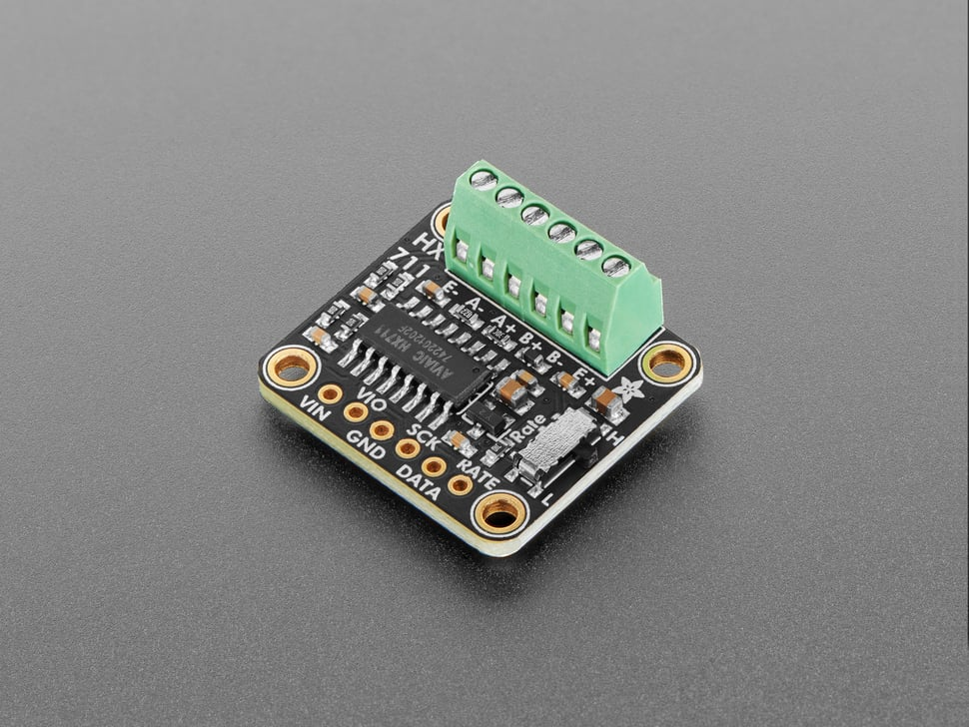
Potential Strain Gauge Circuitry
Difference Amplifier

Slide 45
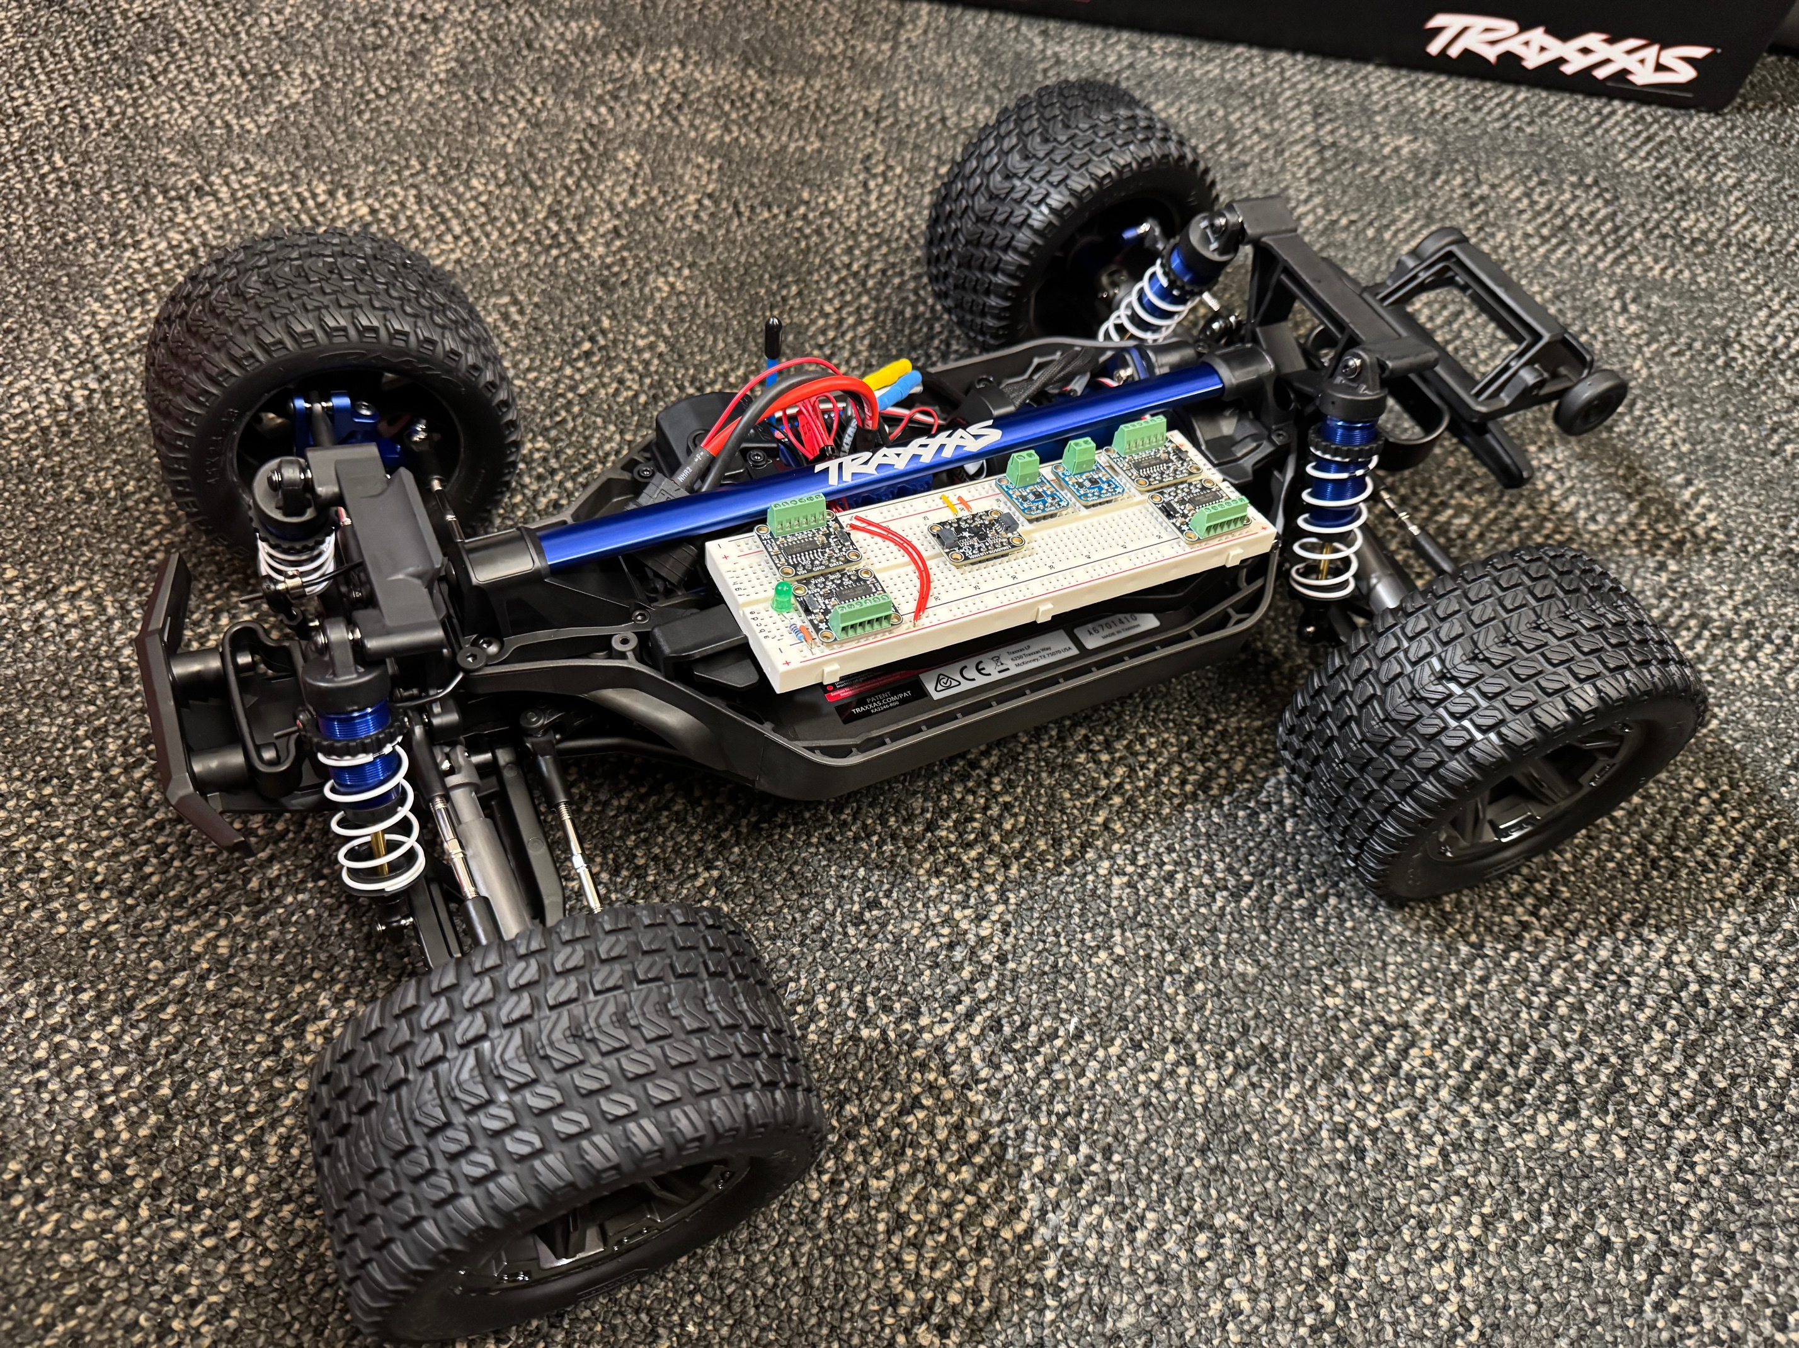
Overall Test Bed
4 Digital Input Pins
Force Transducers
2 Analog Input Pins
Temperature Sensors
1 I2C
IMU
1 Digital or Analog Output
Fan Speed Control
3 Digital Inputs
Encoder PWM Input
Steering PWM Input
Throttle PWM Input

Slide 46
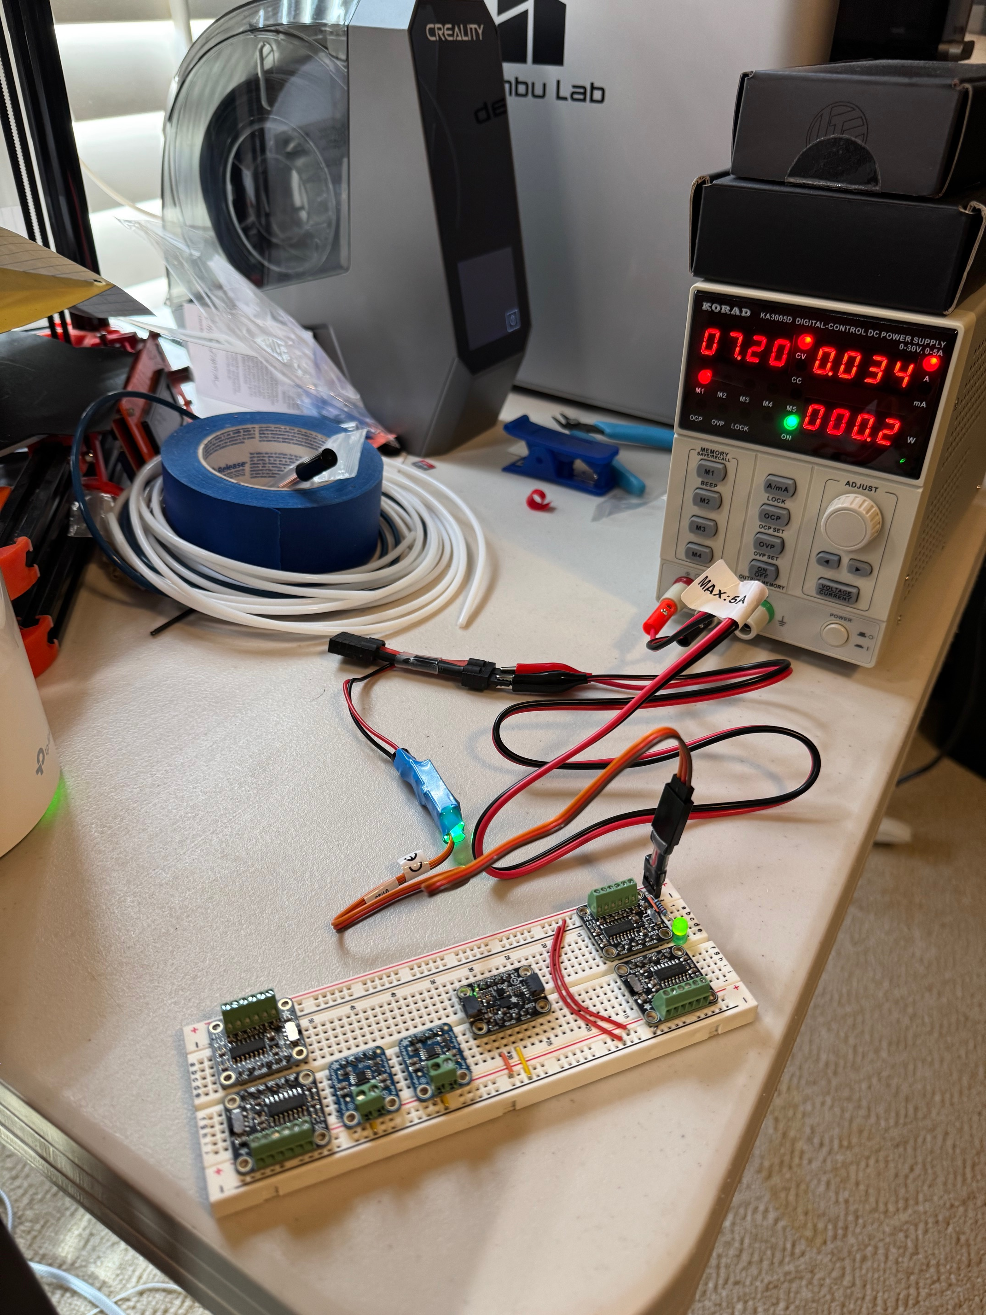

Slide 47
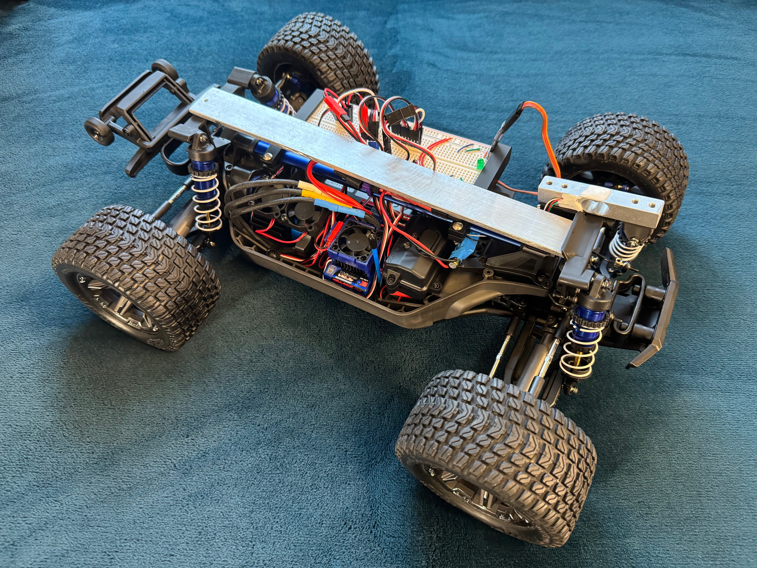
Validation: Next Steps
Install DAQ
Test

Slide 48
Future Developments
Microcontroller
Using I/O Port Expander so that Digital Input Pins can be used with DMA
Hardware
Using a 4+ Layer PCB to reduce vias and size
Adding in a Breaker for Additional MCU Protection
Software
Full Integration of Docker Containers with Cloud with the Database
User Selection & Authentication
Facilitate simultaneous users on the cloud
Validation
Integration with existing ME Lab Setups

